Slide 1
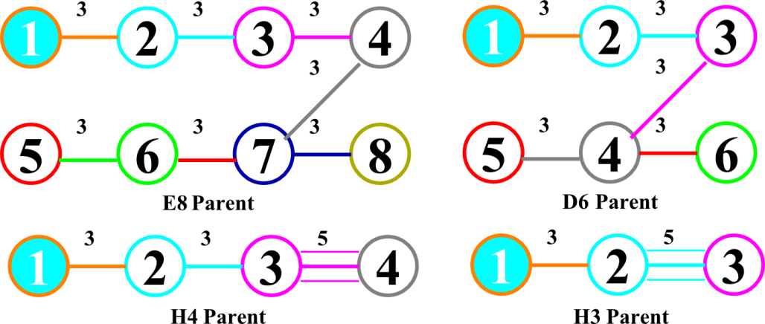
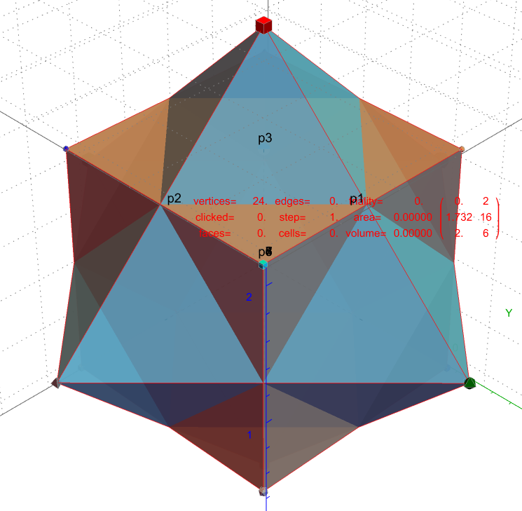
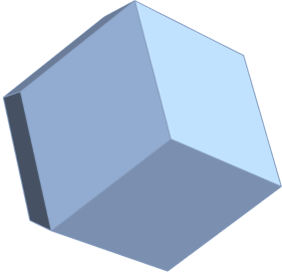
3D & 4D Solids using
Quaternion Weyl Orbits from Coxeter-Dynkin Geometric Group Theory
0D points & vertices
1D lines & edges
2D faces & planes
3D cells & polyhedra
4D cells & polychora
5D-8D cells & polytopes
∞D cells & polytopes

Slide 2
Agenda
Introducing the Mathematica™ based VisibLie-E8 Tool
The Coxeter-Dynkin Visualizer (Groups, Weyl Orbits, Hasse Diagrams, etc.)
The (Bi)Quaternion/(Bi)Octonion/Sedenion Engine (Fano Plane/Cube/Tesseract, etc.)
The VisibLie_E8 Hyperdimensional Visualizer (2D/3D Projections, etc.)
Introducing the Dimensions (0 to 8, ∞)
0D points, 1D edges & 2D faces (A2, B2=C2, G2, H2 Groups)
3D cells & polyhedra (A3, B3, H3 Groups)
4D cells & polychora (A4, C4, D4, F4, H4 Groups)
5D-8D cells & polytopes (A5, C6, D6, E6, E7, E8=BC8+D8 Groups)
Generating Solid Convex Hulls from Quaternions and their Weyl Group Orbits
The 5 Platonic Solids, which includes duals
The 13 Archimedean Solids and their Catalan Duals, with some Johnson and Near-miss Johnsons
4D Polychora w/Duals, including the Dual Snub 24-Cell

Slide 3
Agenda
Introducing the Mathematica™ based VisibLie-E8 Tool
The Coxeter-Dynkin Visualizer (Groups, Weyl Orbits, Hasse Diagrams, etc.)
The (Bi)Quaternion/(Bi)Octonion/Sedenion Engine (Fano Plane/Cube/Tesseract, etc.)
The VisibLie_E8 Hyperdimensional Visualizer (2D/3D Projections, etc.)
Introducing the Dimensions (0 to 8, ∞)
0D points, 1D edges & 2D faces (A2, B2=C2, G2, H2 Groups)
3D cells & polyhedra (A3, B3, H3 Groups)
4D cells & polychora (A4, C4, D4, F4, H4 Groups)
5D-8D cells & polytopes (A5, C6, D6, E6, E7, E8=BC8+D8 Groups)
Generating Solid Convex Hulls from Quaternions and their Weyl Group Orbits
The 5 Platonic Solids, which includes duals
The 13 Archimedean Solids and their Catalan Duals, with some Johnson and Near-miss Johnsons
4D Polychora w/Duals, including the Dual Snub 24-Cell

Slide 4
Introducing the Mathematica™ based VisibLie-E8 Tool
J Gregory Moxness
JGMoxness@TheoryOfEverything.org
For more detail information online please click here.
Citations to source material found in this presentation:
Koca, Mehmet; Ozdes Koca, Nazife; Koc, Ramazon (2010). "Catalan Solids Derived From 3D-Root Systems and Quaternions". Journal of Mathematical Physics. 51 (4). arXiv:0908.3272. doi:10.1063/1.3356985.
Koca, Mehmet; Al-Ajmi, Mudhahir; Ozdes Koca, Nazife (2011). "Quaternionic representation of snub 24-cell and its dual polytope derived from E8 root system". Linear Algebra and Its Applications. 434 (4): 977–989. doi:10.1016/j.laa.2010.10.005. ISSN 0024-3795. S2CID 18278359.

Slide 5
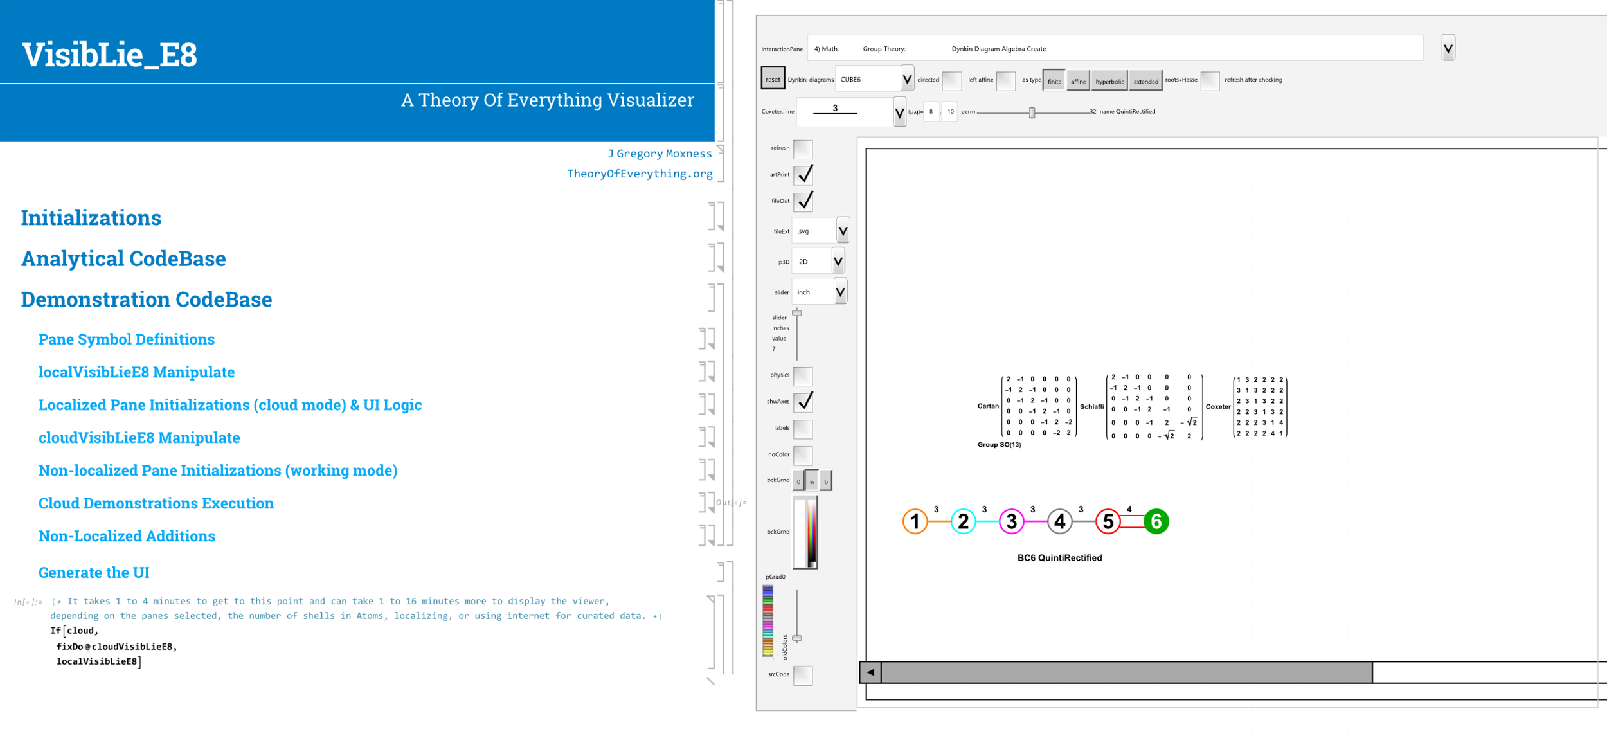
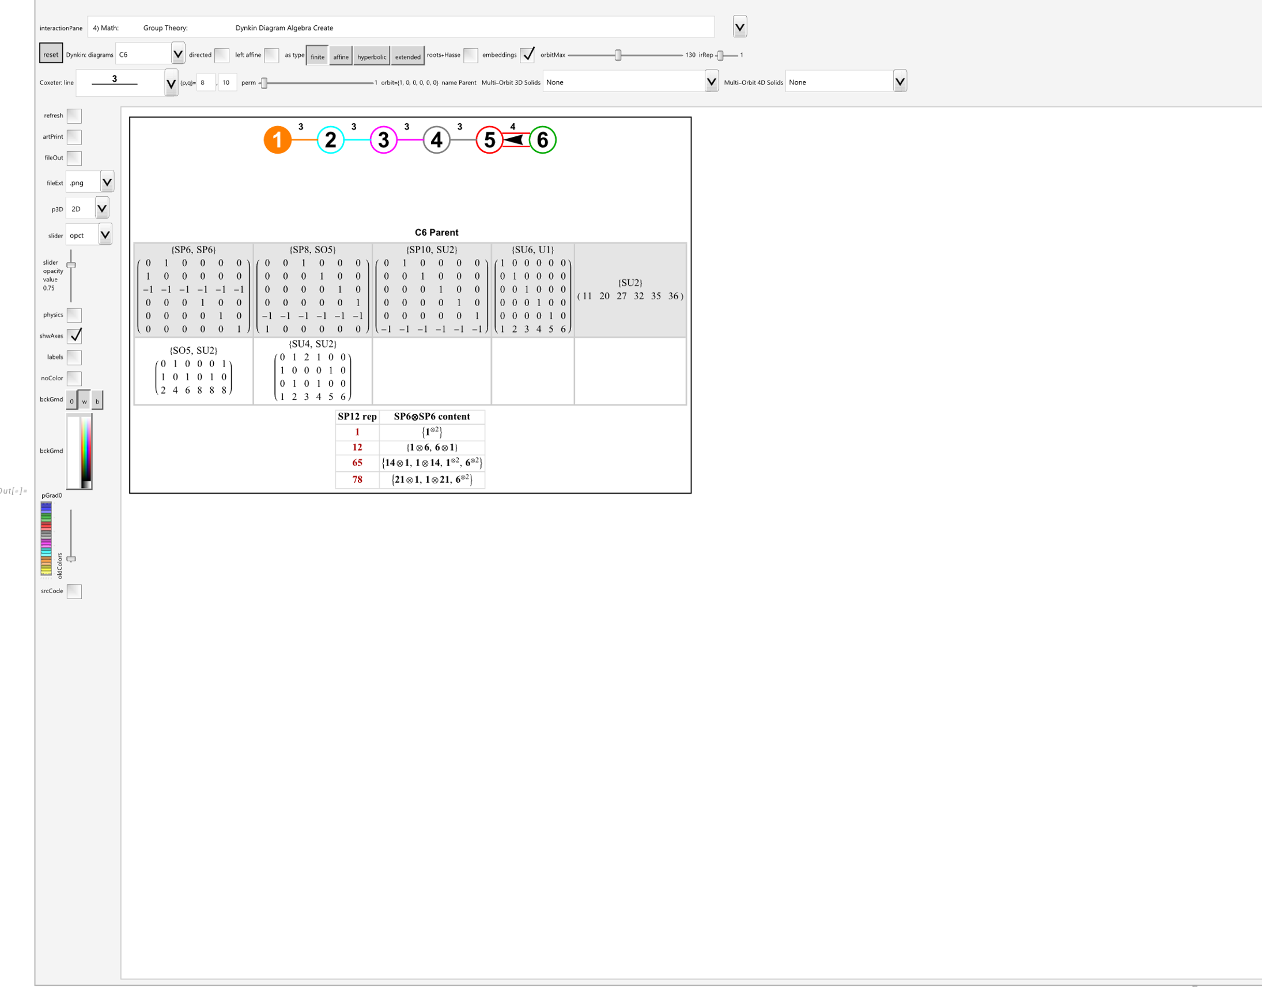
Introducing The VisibLie_E8 Tool
The code is written to be able to run locally with full capability or in demonstrations over the web in the cloud. It contains 18 integrated mathematical demonstration sections that work together to understand the relationships between math, physics, chemistry, genetics, neurology, AI, and more.
Just select the cells on the right and shift-click to run the entire notebook.

Slide 6
Introducing The VisibLie_E8 Tool
The left-side bar is common to all demonstrations and allows visualizing results in 2D, 3D, stereo and anaglyph (red-cyan glasses), control the number of time-steps for video animations, etc.
You can select color schemes, view code snippets, change opacity, resolutions, turning on/off coordinate axis, vertex labels, turn on file exports, and change export file types.
The physics button shows theoretical quantum particle assignments based on E8 group theoretic considerations.
The top bar changes to accommodate individual options and selections related to each numbered demonstration pane. Sometimes, user selectable options are provided within the output pane when there is insufficient room in the top bar.
The output pane can also be interactive with mouse click-drag features in both 2D and 3D.
The shown output is pane #4 for Coxeter-Dynkin visualizations.

Slide 7
The Coxeter-Dynkin Visualizer Demonstration Pane (#4)
You can select which Coxeter-Dynkin group to view from the drop down or create a unique one using the main area of the interactive clickable UI to add nodes and change connection types.
This button allows the detail visualization of the maximal embeddings of the selected Lie Algebra, with options for selecting the number of dimensions to search and which of the found embeddings to display.
This checkbox is selected – so it is showing the embeddings of C6.
These buttons modify the Dynkin diagram based on which button is selected. The 2^{n} Weyl orbit permutation slider allows the selection of which polytope orbit to visualize in 3D. Drop down menus at the right on the 2nd row allow for explicit selections for visualizing the quaternionWeyl orbit generated Platonic and Archimedian solids with Catalan duals as well as the A4 4D solids and their duals.
This button allows the detail visualization of the Hasse diagram, along with group theoretic concepts (i.e. Cartan matrix determinant, group dimensions, weights, positive roots, heights, etc.)

Slide 8
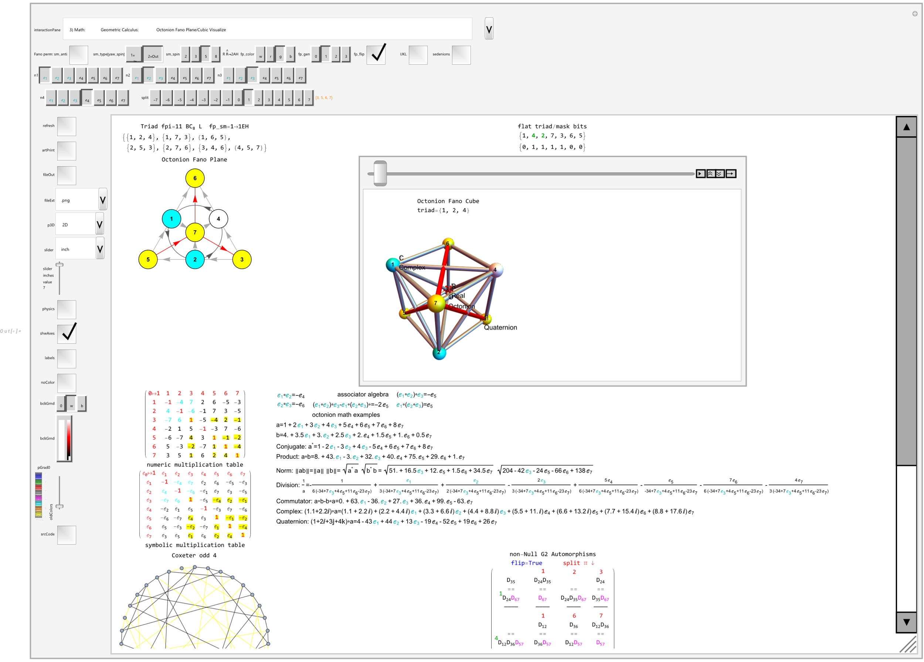
The (Bi)Quaternion / (Bi)Octonion / Sedenion Engine (#3)
The resulting Fano plane and animated cube (or tesseract for sedenions) can be shown, along with the multiplication tables in various formats, including the older IJKL style. Internal code sets options for working with complexified quaternion/octonion math as needed.
Example related math includes associators, sedenion zero divisors, and visualizations for G2 automorphisms and Coxeter Odd 4 graph are also shown.
While there are only two possible variations of quaternions with one being standardized, there are 480 different octonions. This visualizer allows you to select any of those and select various split octonions based on triads or dimensions.

Slide 9
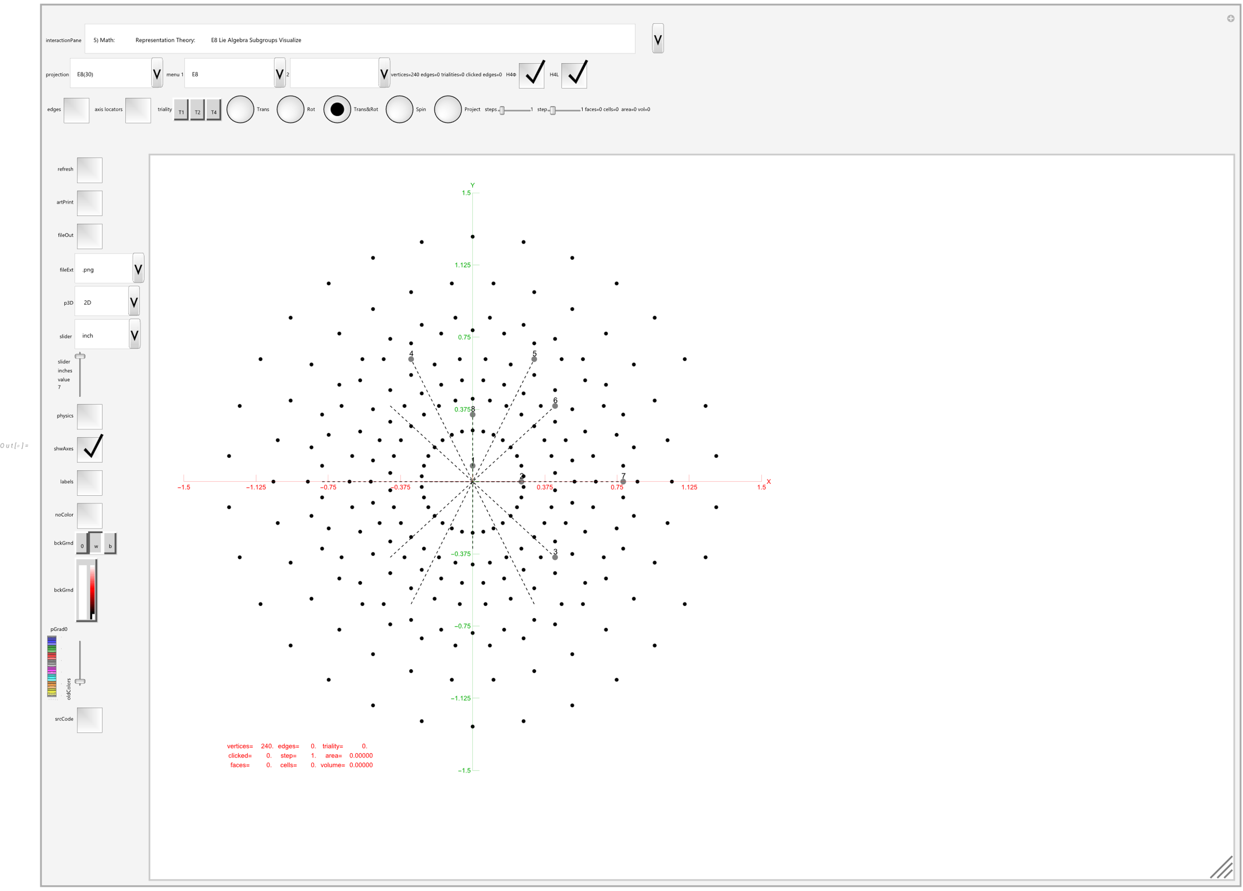
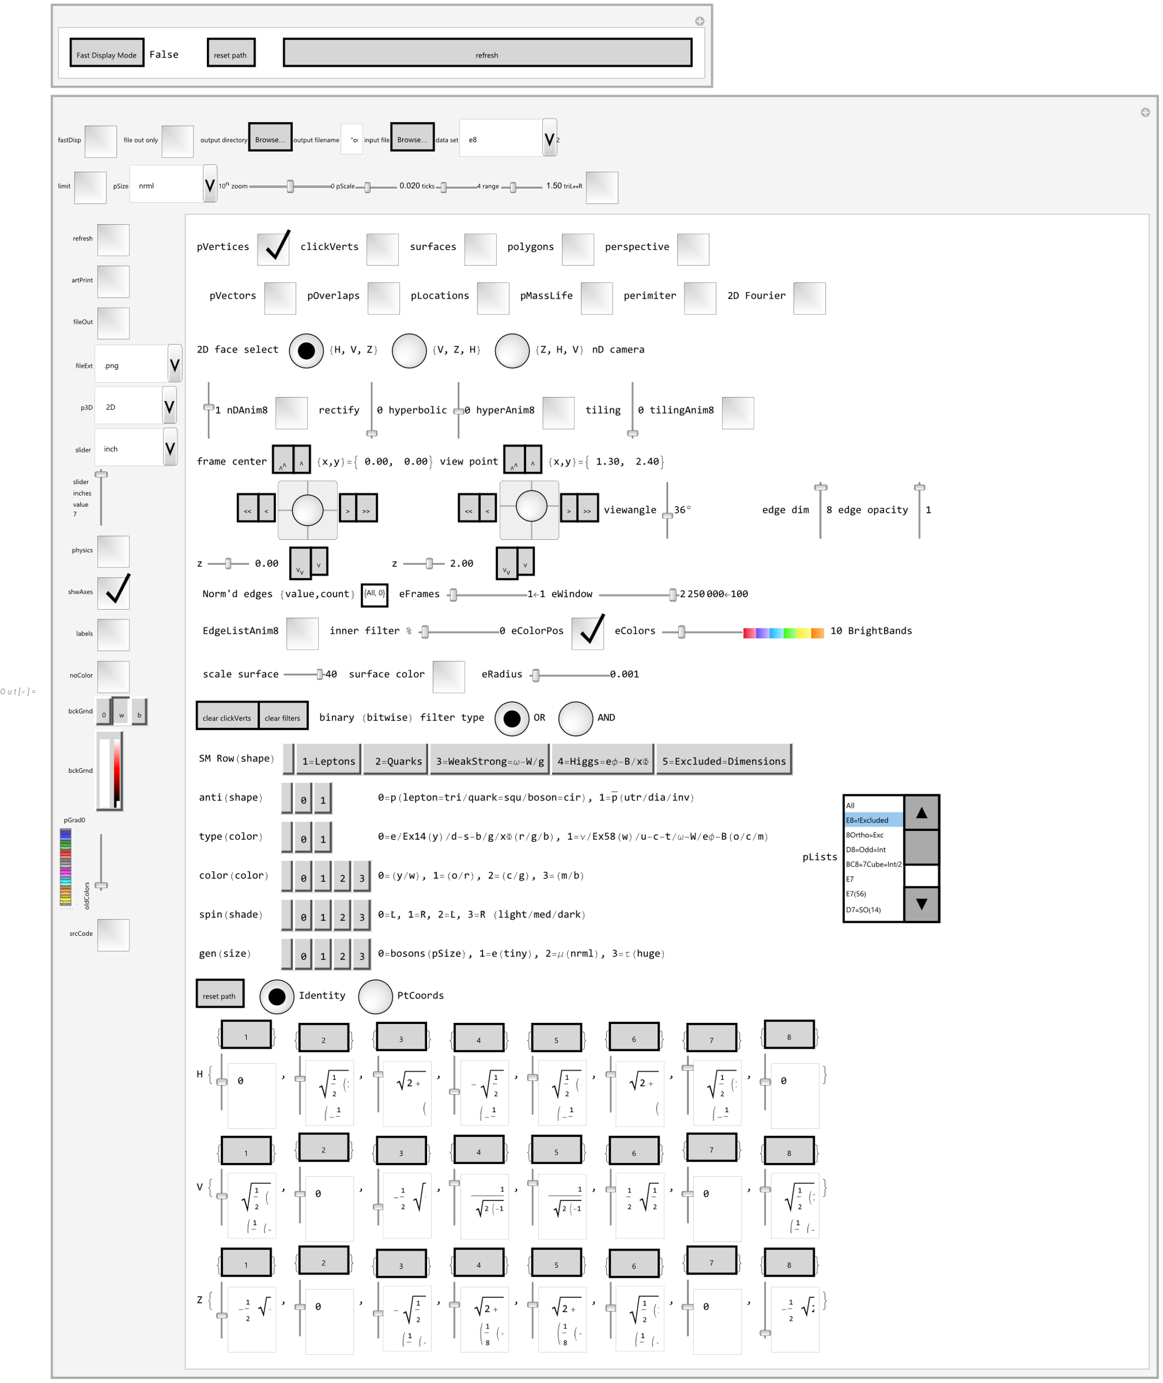
The VisibLie_E8 Hyperdimensional Visualizer Pane (#5)
There are a large number of predefined favorites in the drop-down menus, along with buttons to augment these.
There is also pane #18 provided as a UI for a huge number of visualization options. These are all selectable by switching panes or using a second window, or setting the option using Mathematica code outside of the demonstrations.
This is the main geometry visualization engine for E8 and all of its related sub-groups. While the code works in this UI, it also is used outside of the UI to create specific output, such as that used in this presentation.

Slide 10
Agenda
Introducing the Mathematica™ based VisibLie-E8 Tool
The Coxeter-Dynkin Visualizer (Groups, Weyl Orbits, Hasse Diagrams, etc.)
The (Bi)Quaternion/(Bi)Octonion/Sedenion Engine (Fano Plane/Cube/Tesseract, etc.)
The VisibLie_E8 Hyperdimensional Visualizer (2D/3D Projections, etc.)
Introducing the Dimensions (0 to 8, ∞)
0D points, 1D edges & 2D faces (A2, B2=C2, G2, H2 Groups)
3D cells & polyhedra (A3, B3, H3 Groups)
4D cells & polychora (A4, C4, D4, F4, H4 Groups)
5D-8D cells & polytopes (A5, C6, D6, E6, E7, E8=BC8+D8 Groups)
Generating Solid Convex Hulls from Quaternions and their Weyl Group Orbits
The 5 Platonic Solids, which includes duals
The 13 Archimedean Solids and their Catalan Duals, with some Johnson and Near-miss Johnsons
4D Polychora w/Duals, including the Dual Snub 24-Cell

Slide 11
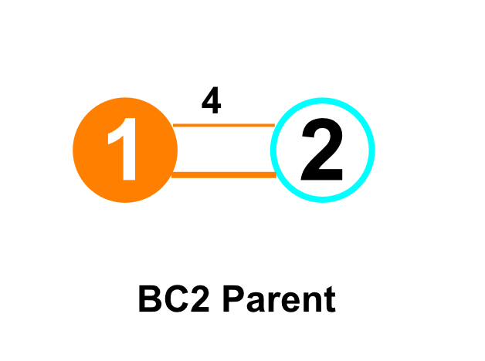
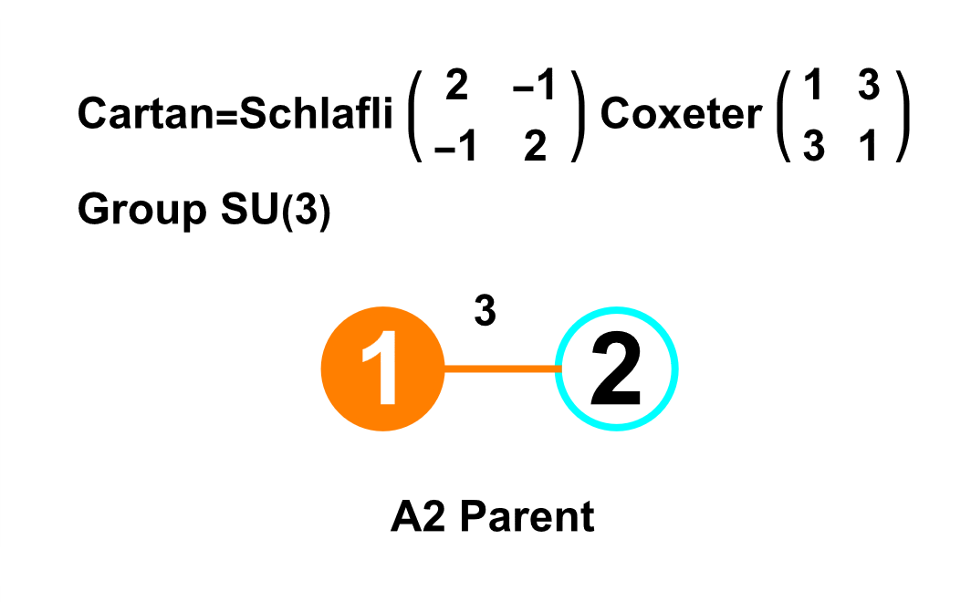
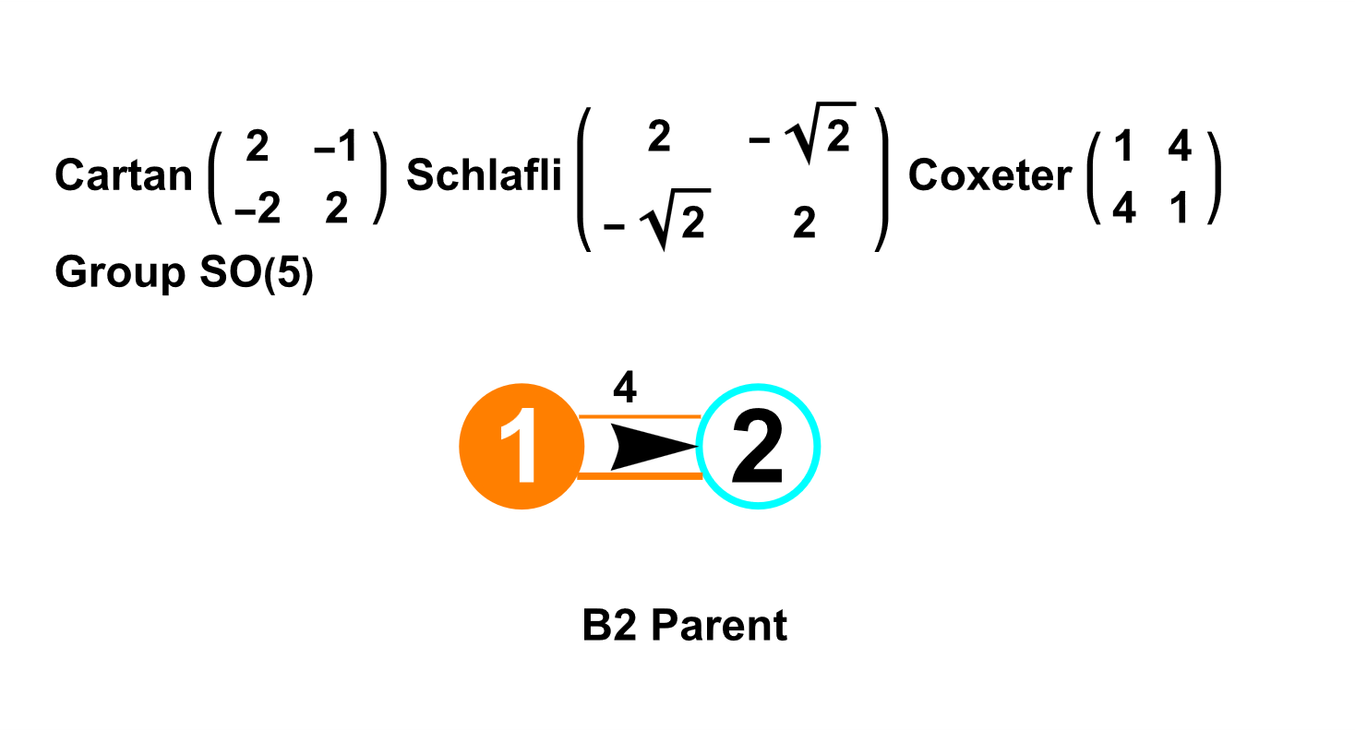
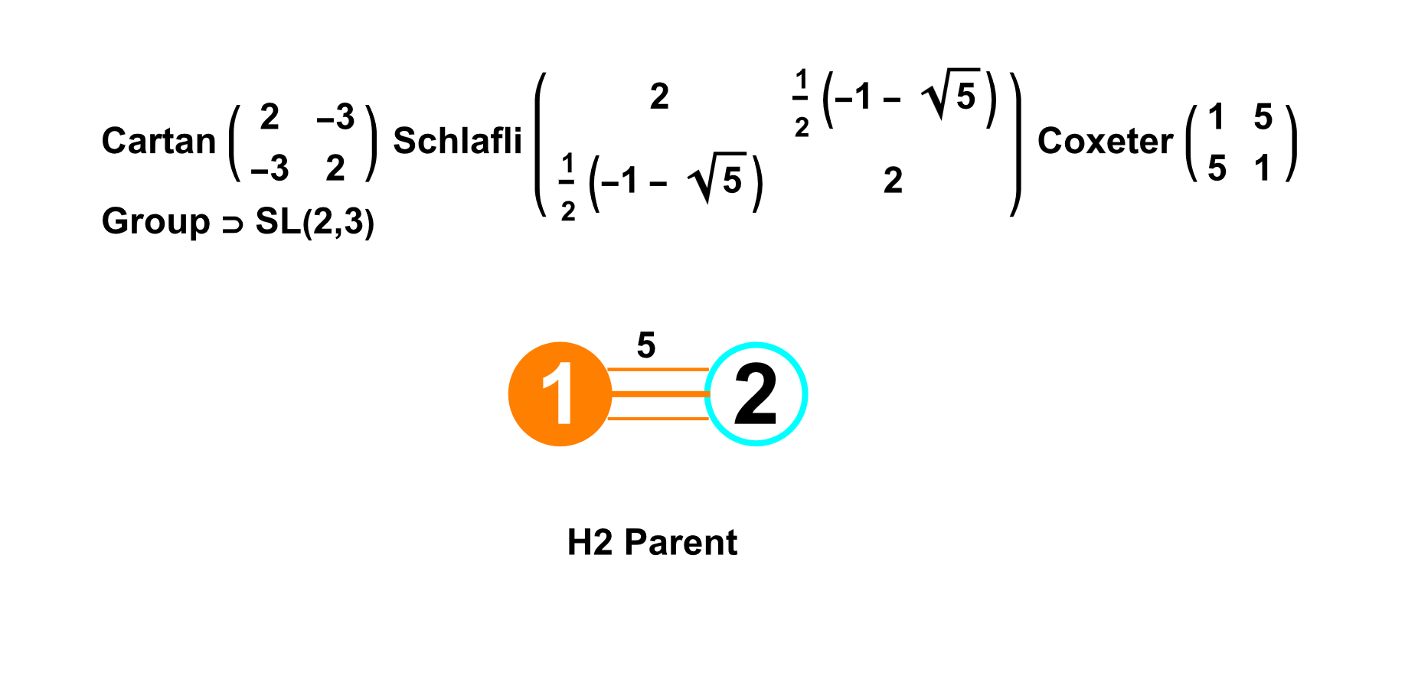
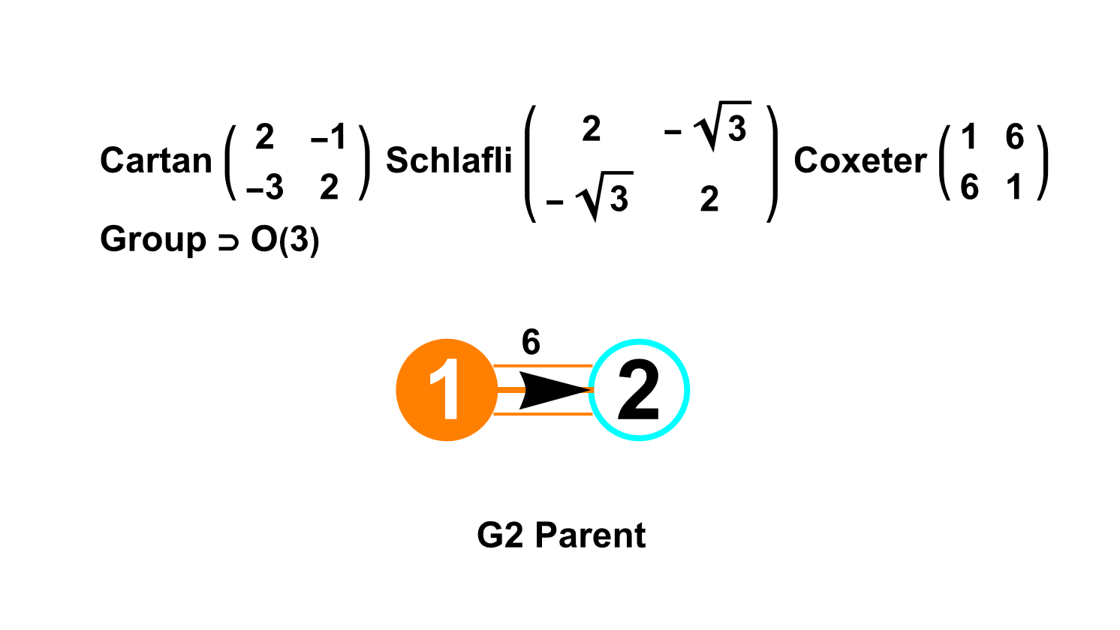
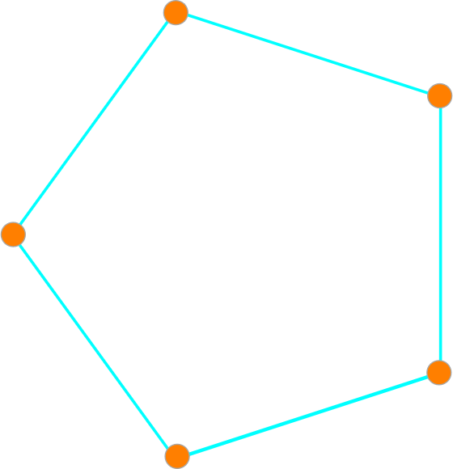
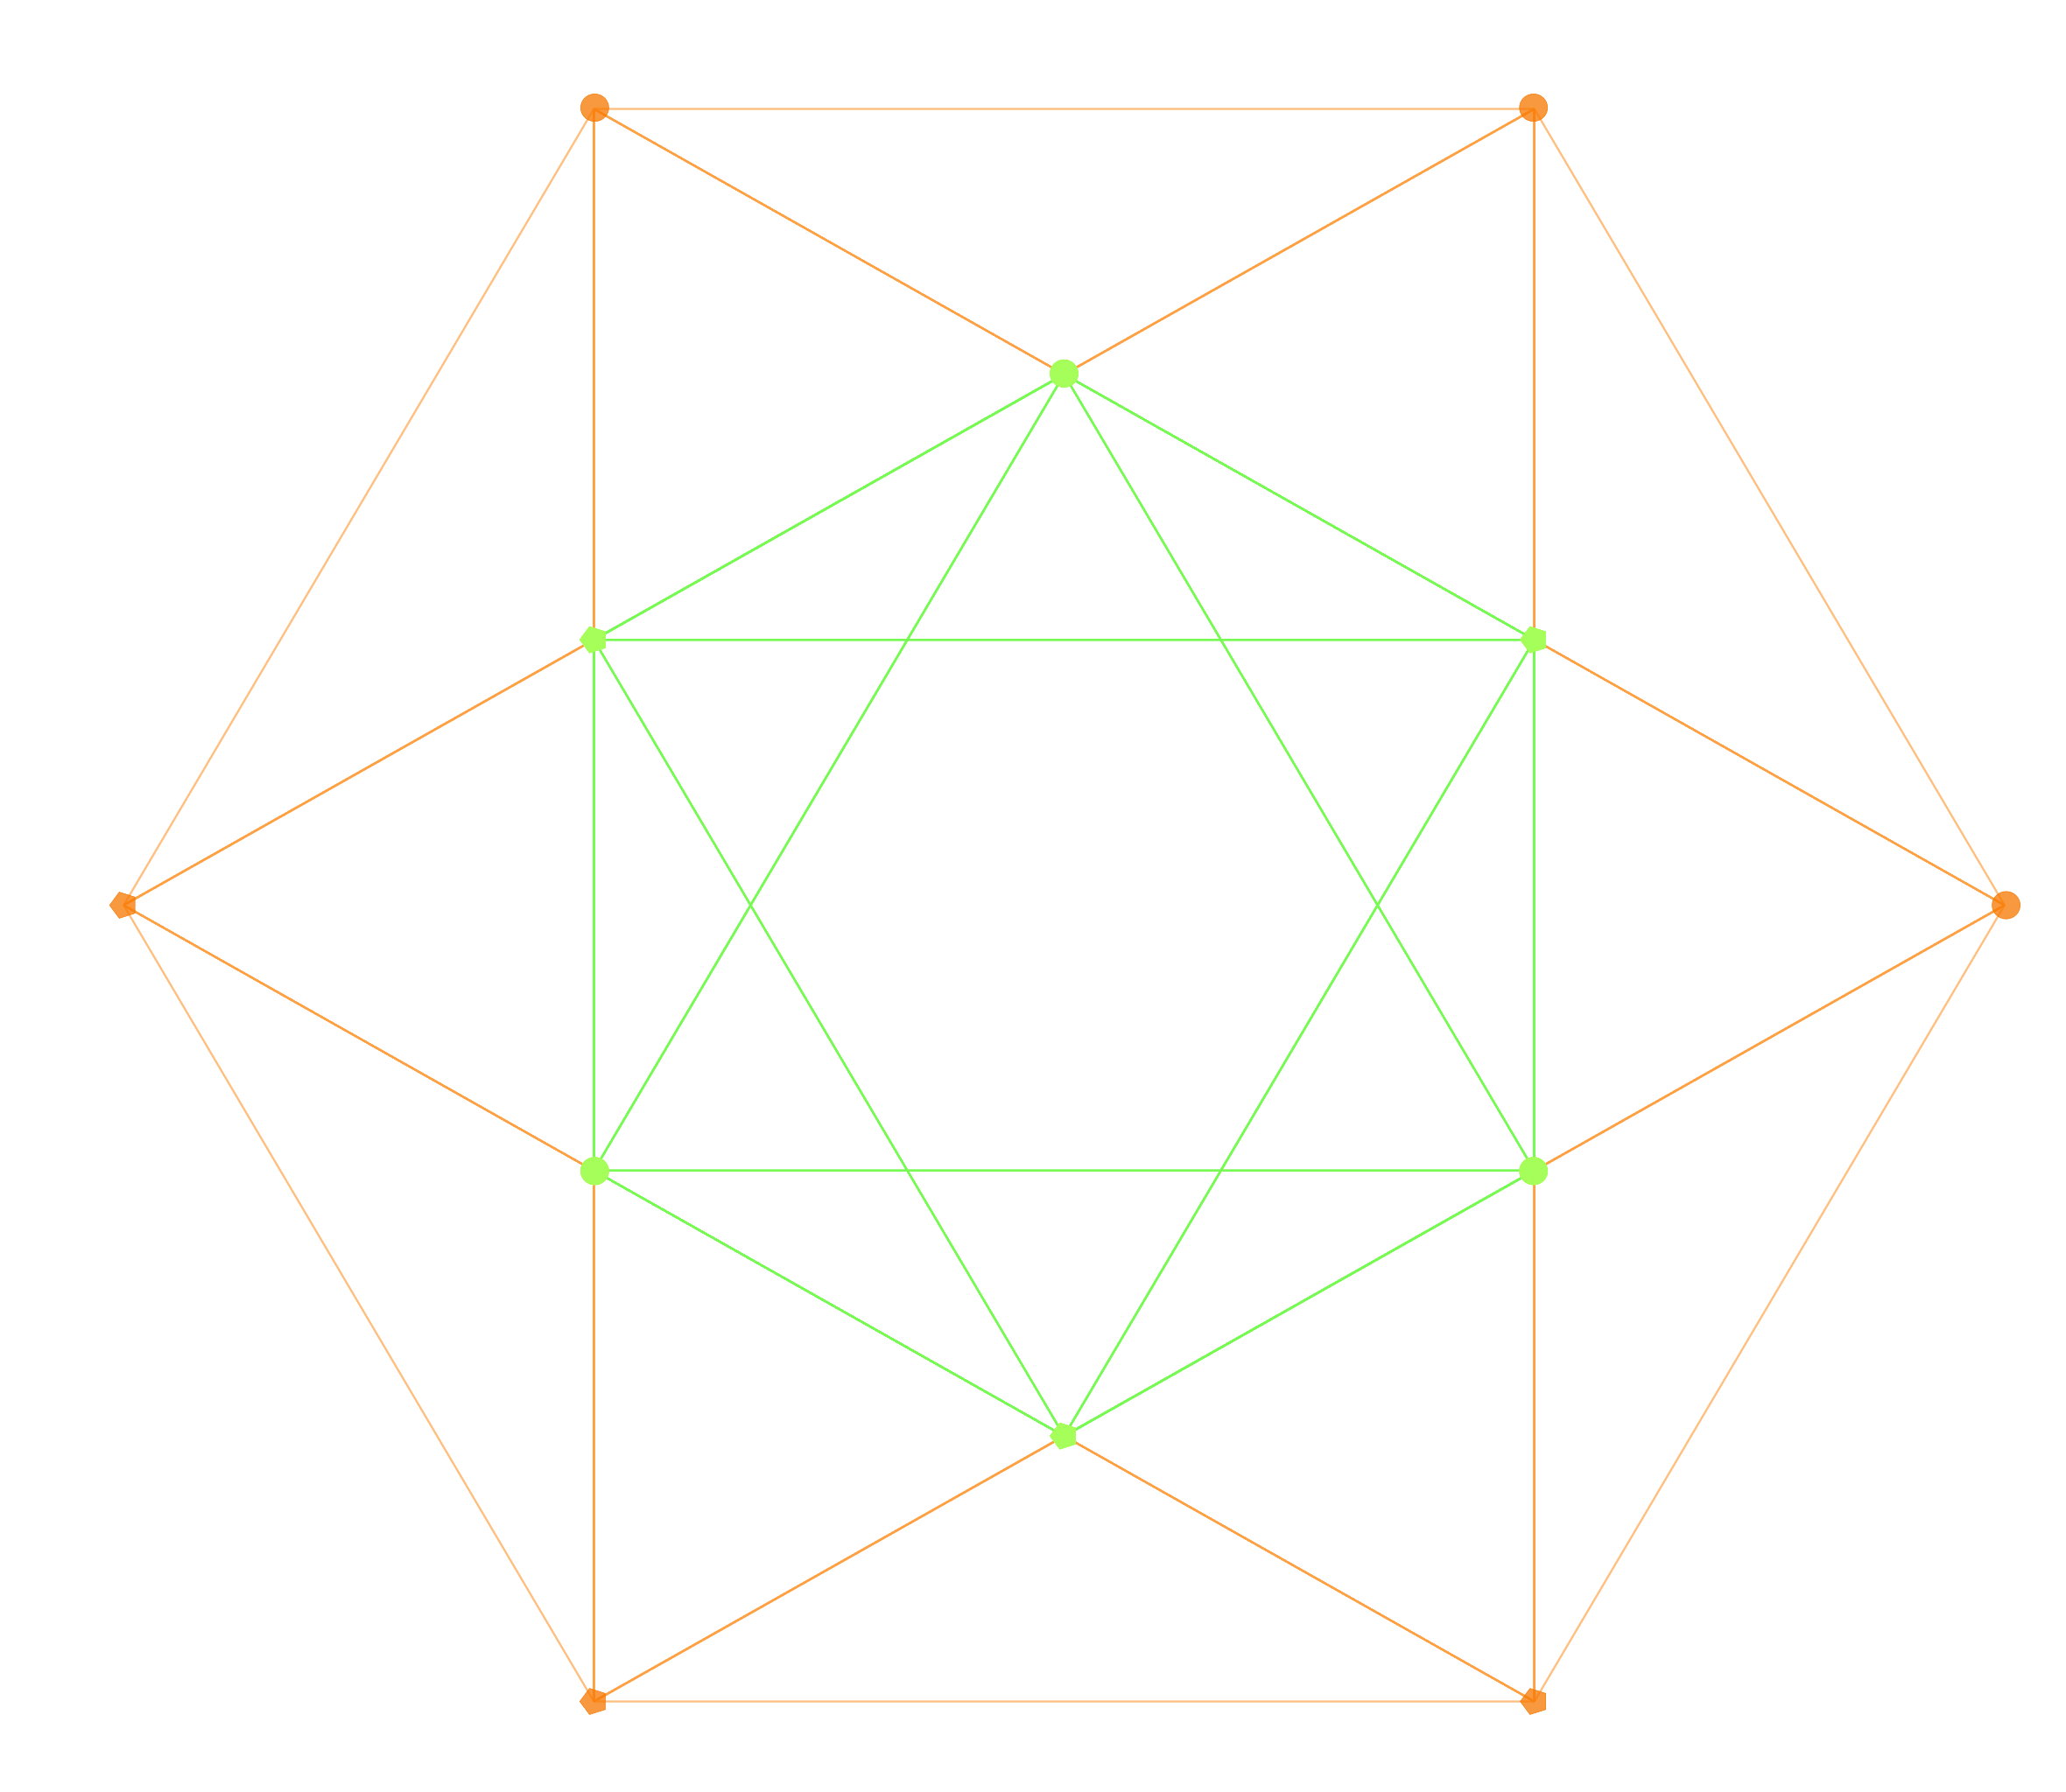
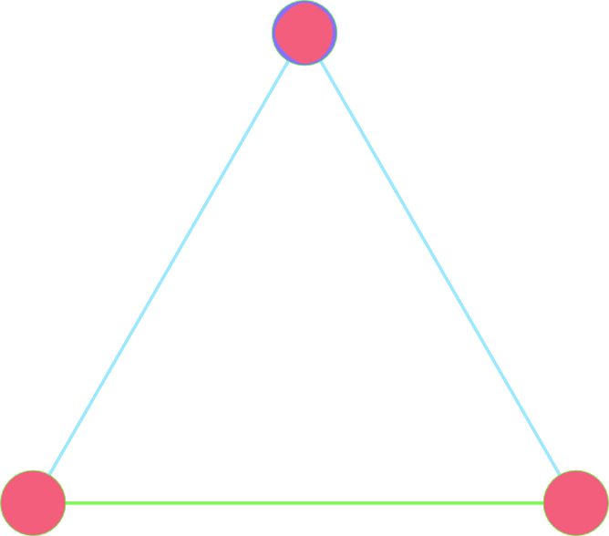
2D edges & faces (A2, B2=C2, H2, G2 Groups)
Triangle (A3) Square (BC2) Pentagon (H2) Hexagon(G2)

Slide 12
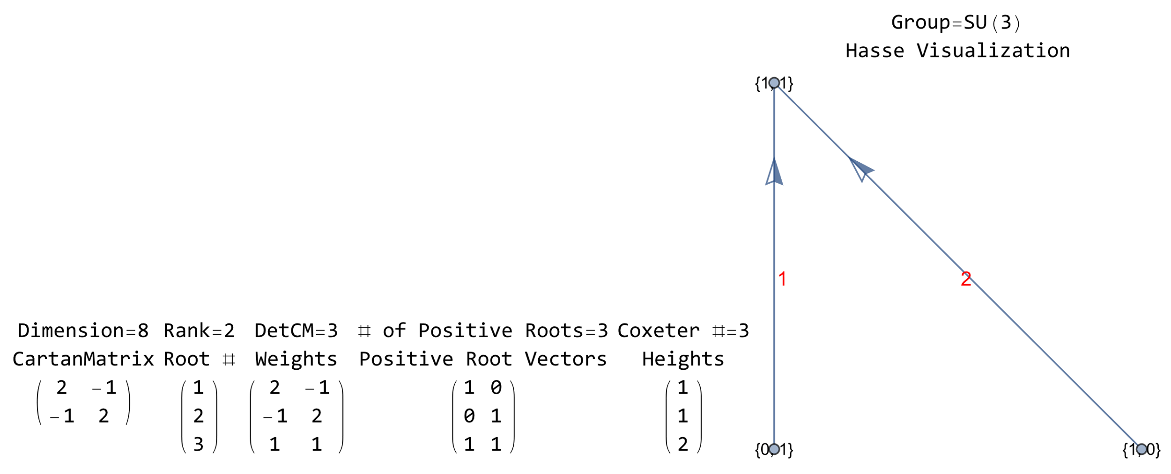
2D edges & faces (A2, B2=C2, H2, G2 Groups)

Slide 13
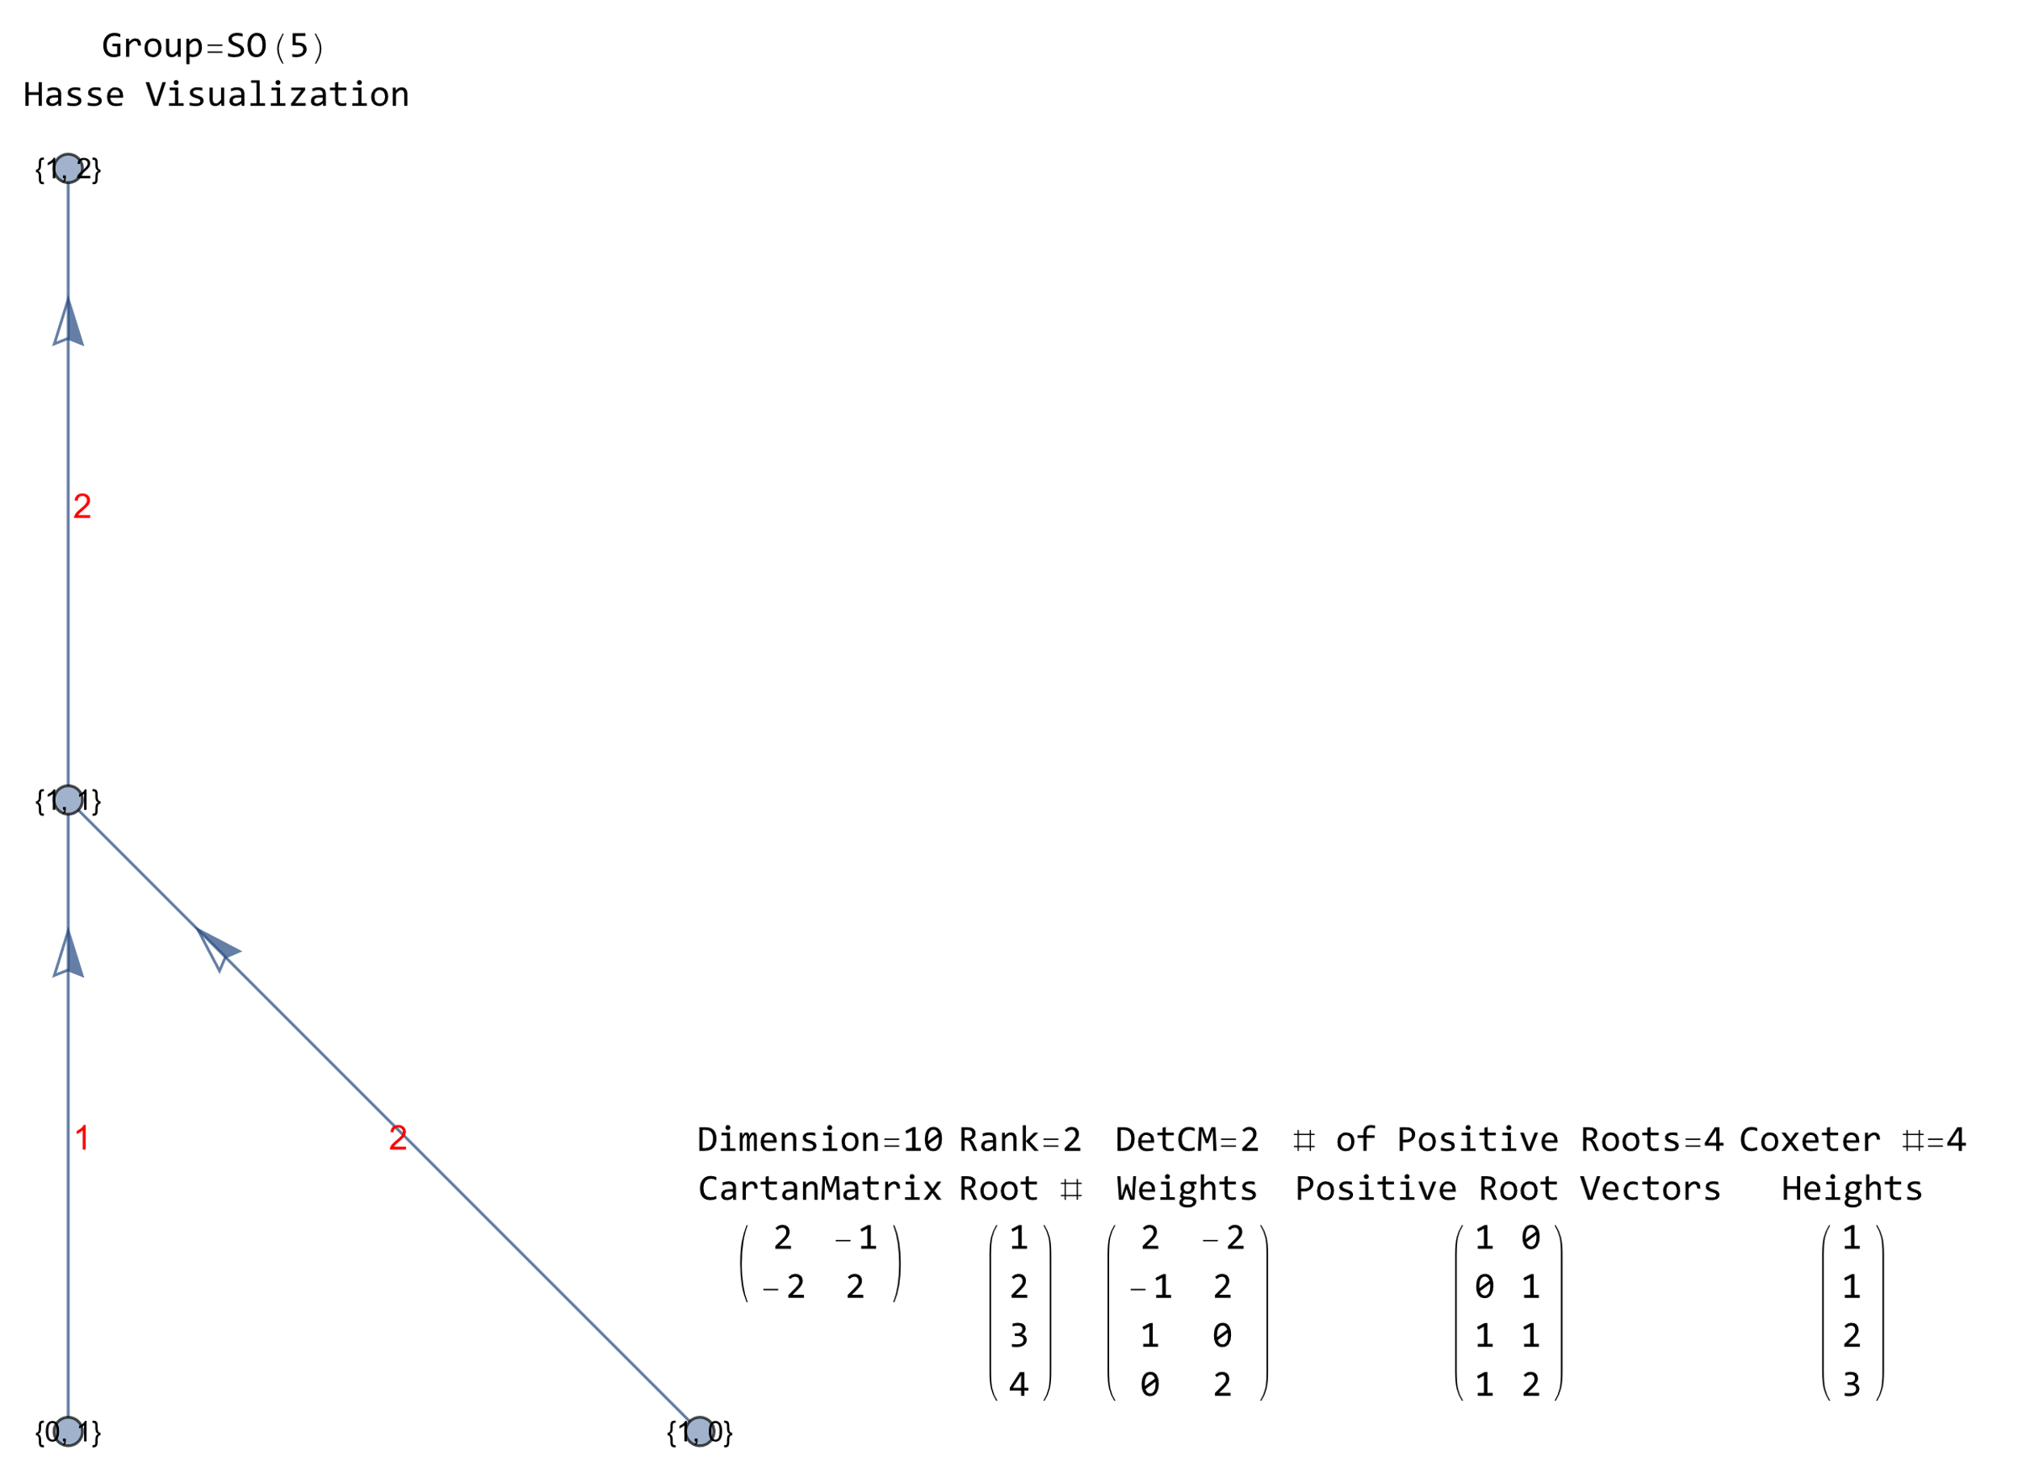
2D edges & faces (A2, B2=C2, H2, G2 Groups)

Slide 14
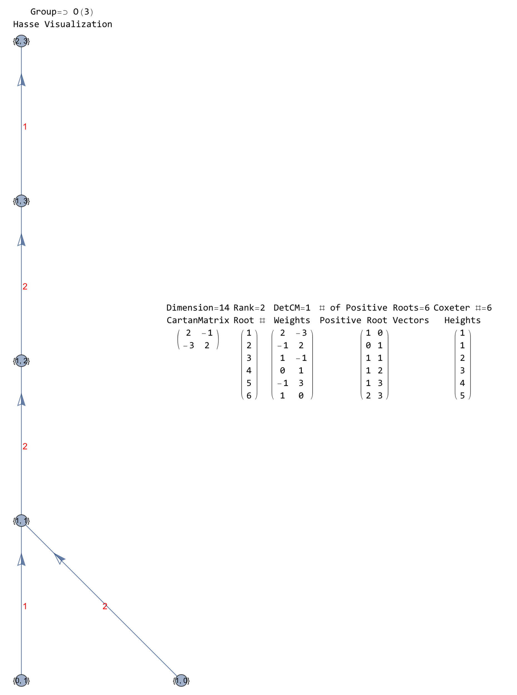
2D edges & faces (A2, B2=C2, H2, G2 Groups)

Slide 15
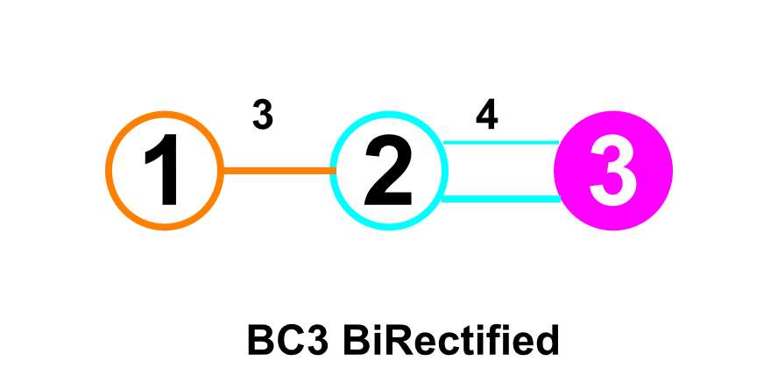
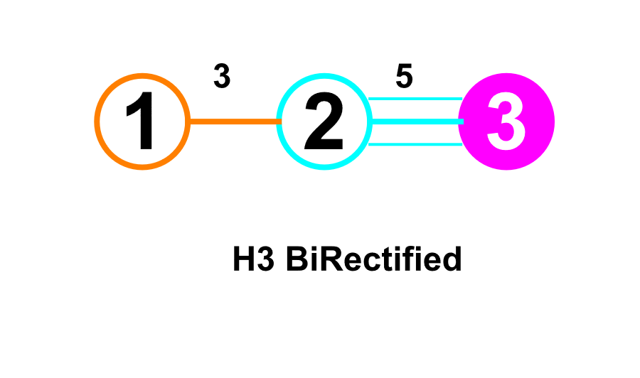
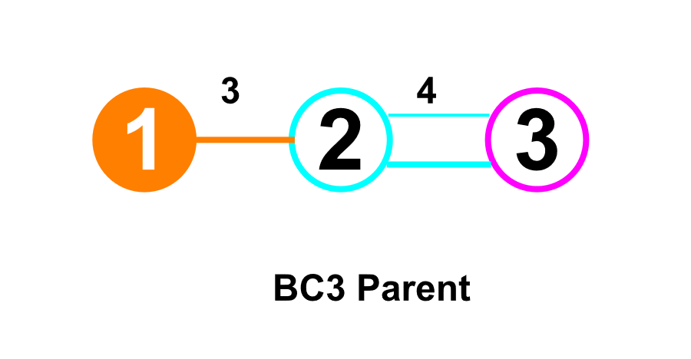
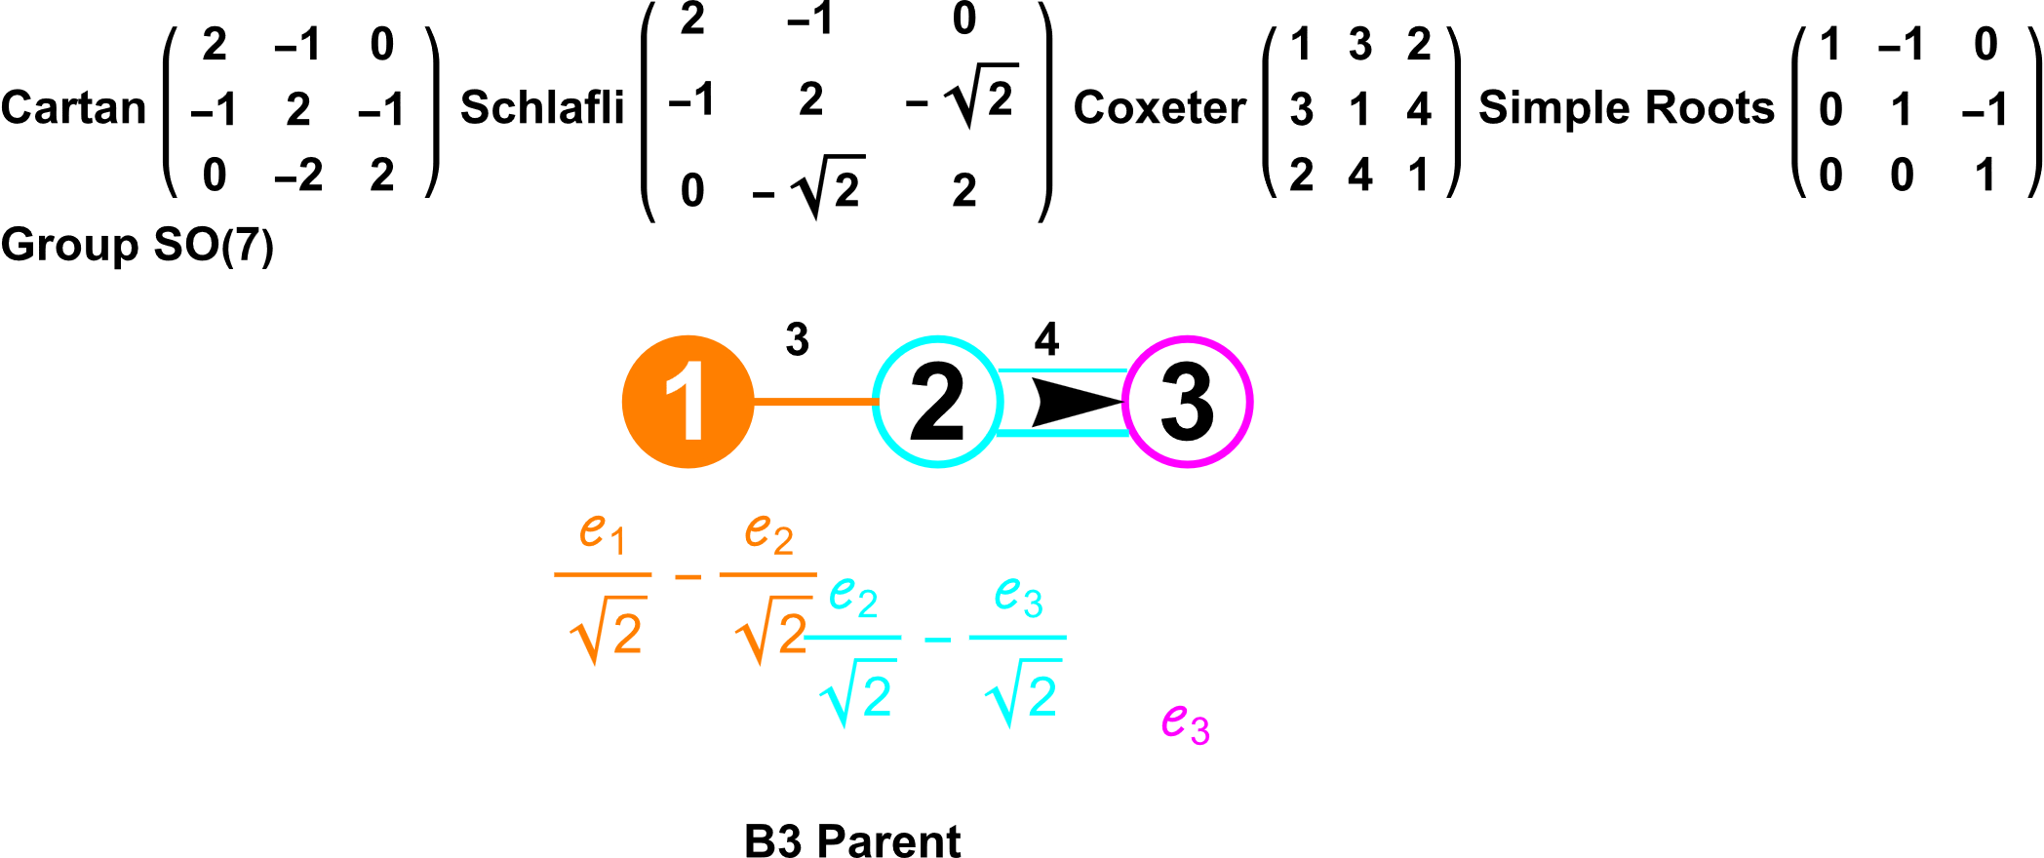
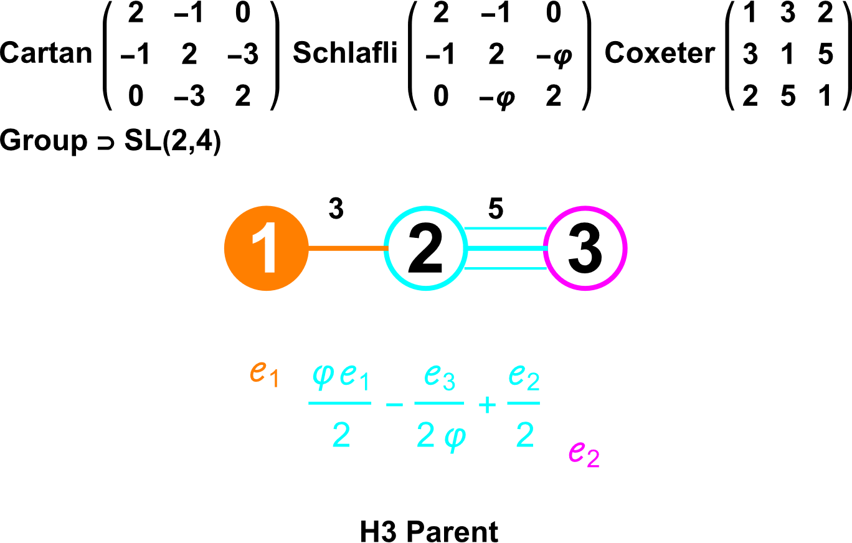
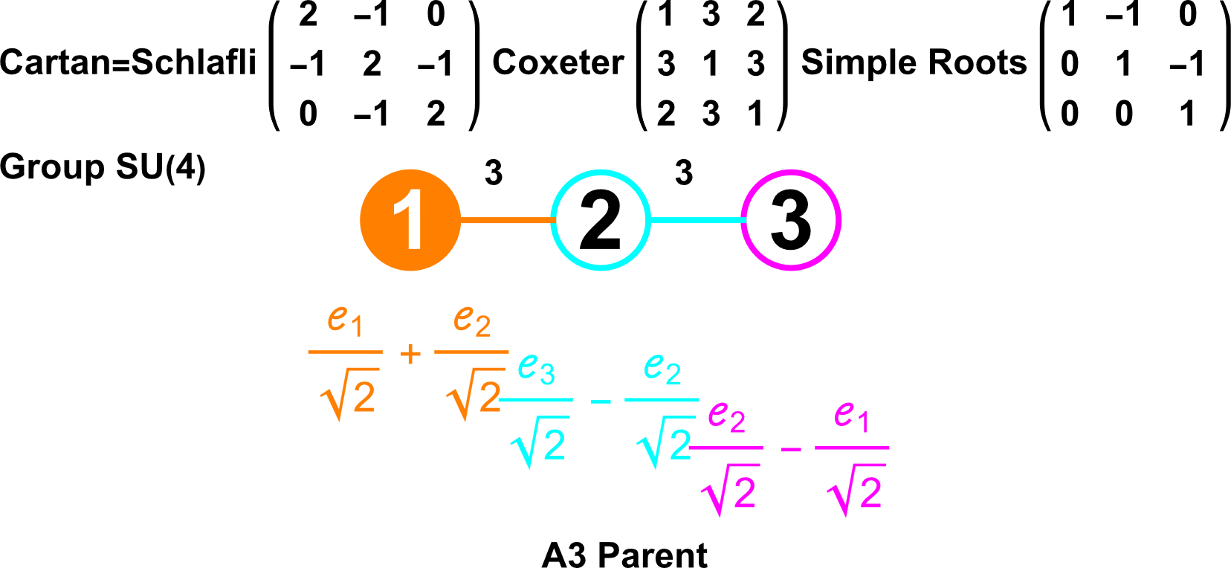
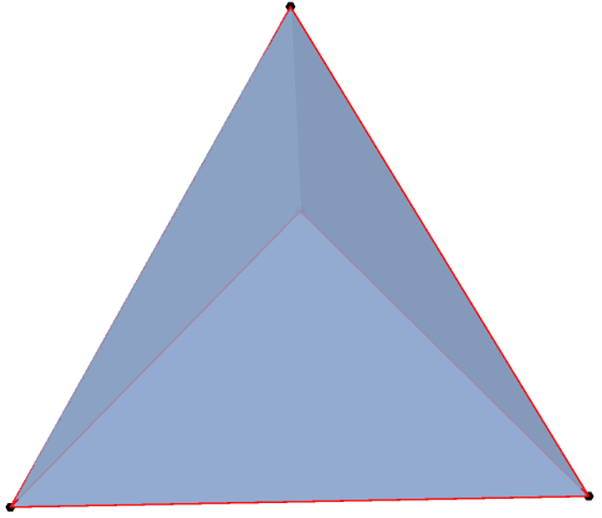
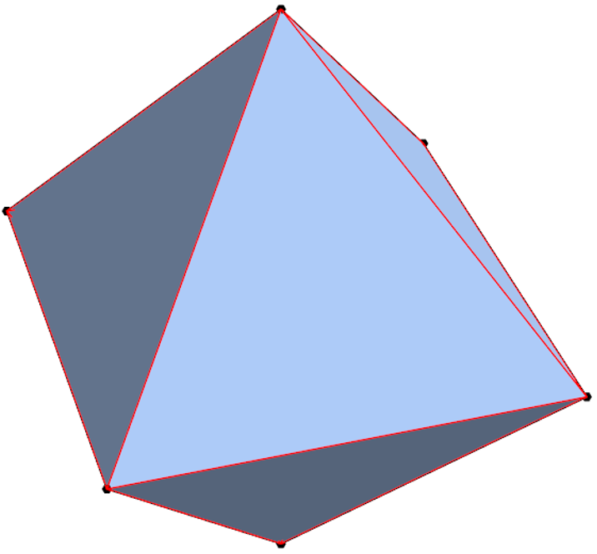
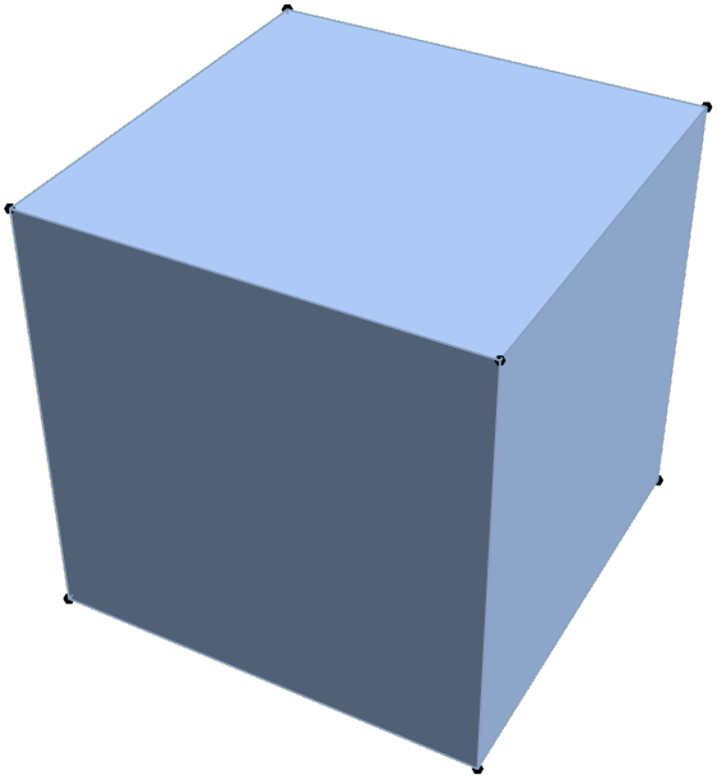
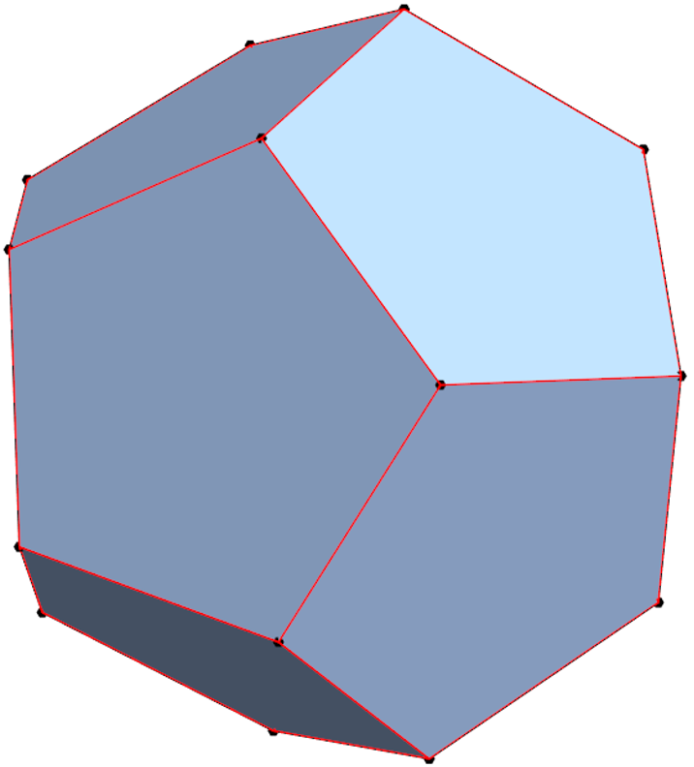
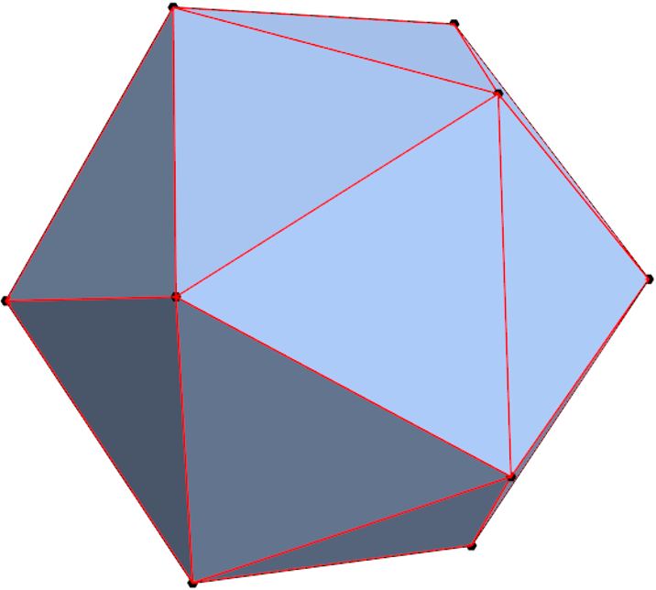
3D cells & polyhedra (A3, BC3, H3) Showing Platonic Solids
8=2^{n=3} permutations of filled (aka. ringed) nodes which represent Weyl orbits that generate sets of vertices, edges, faces, and cells. The names are generated based on permutations of:
Tetrahedron (A3) Octahedron (BC3) Icosahedron (H3)
Self Dual Cube (BC3 BiRectified) Dodecahedron (H3 BiRectified)

Slide 16
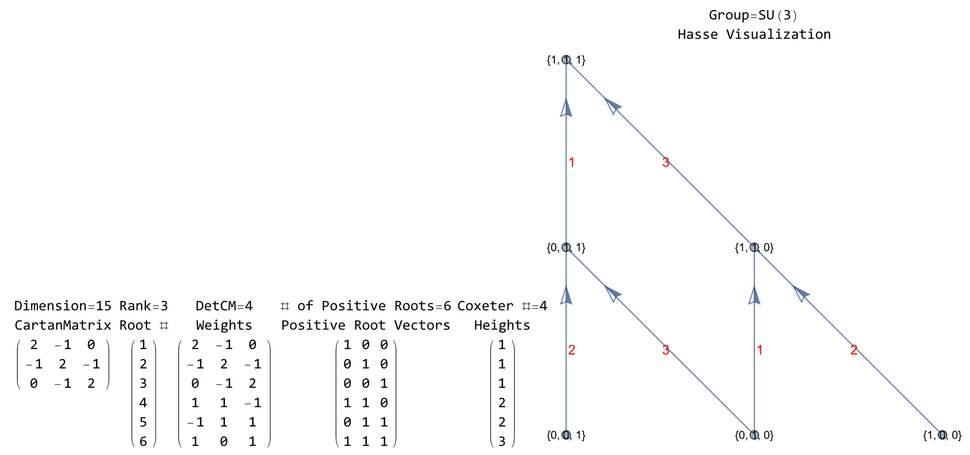
3D cells & polyhedra (A3, B3, H3)

Slide 17
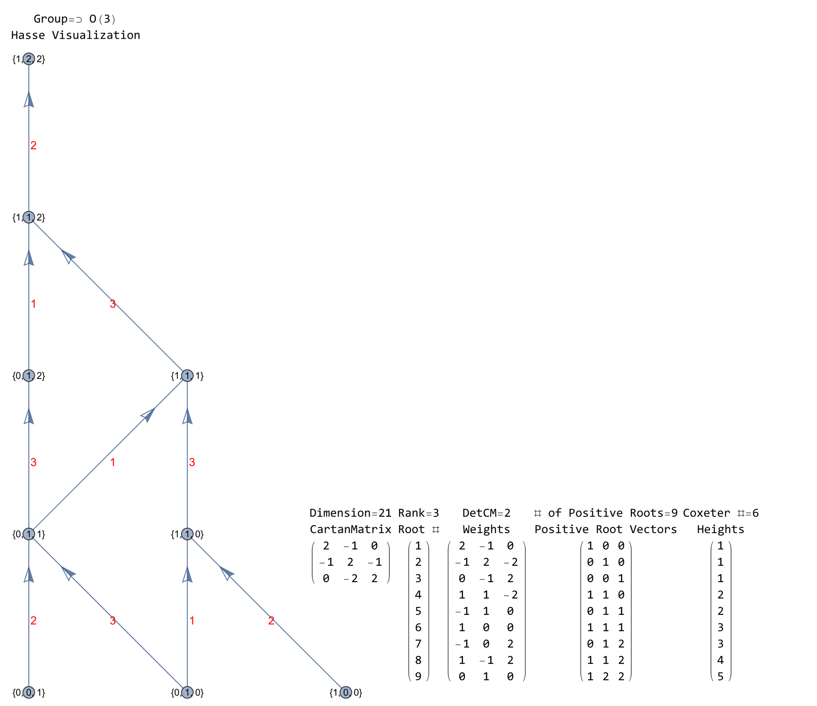
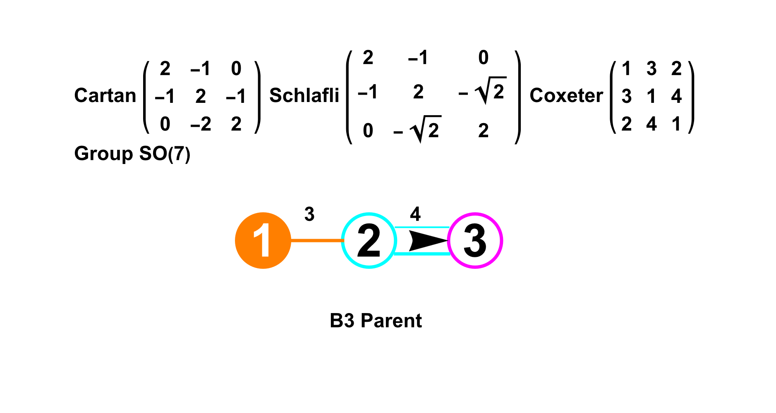
3D cells & polyhedra (A3, B3, H3)

Slide 18
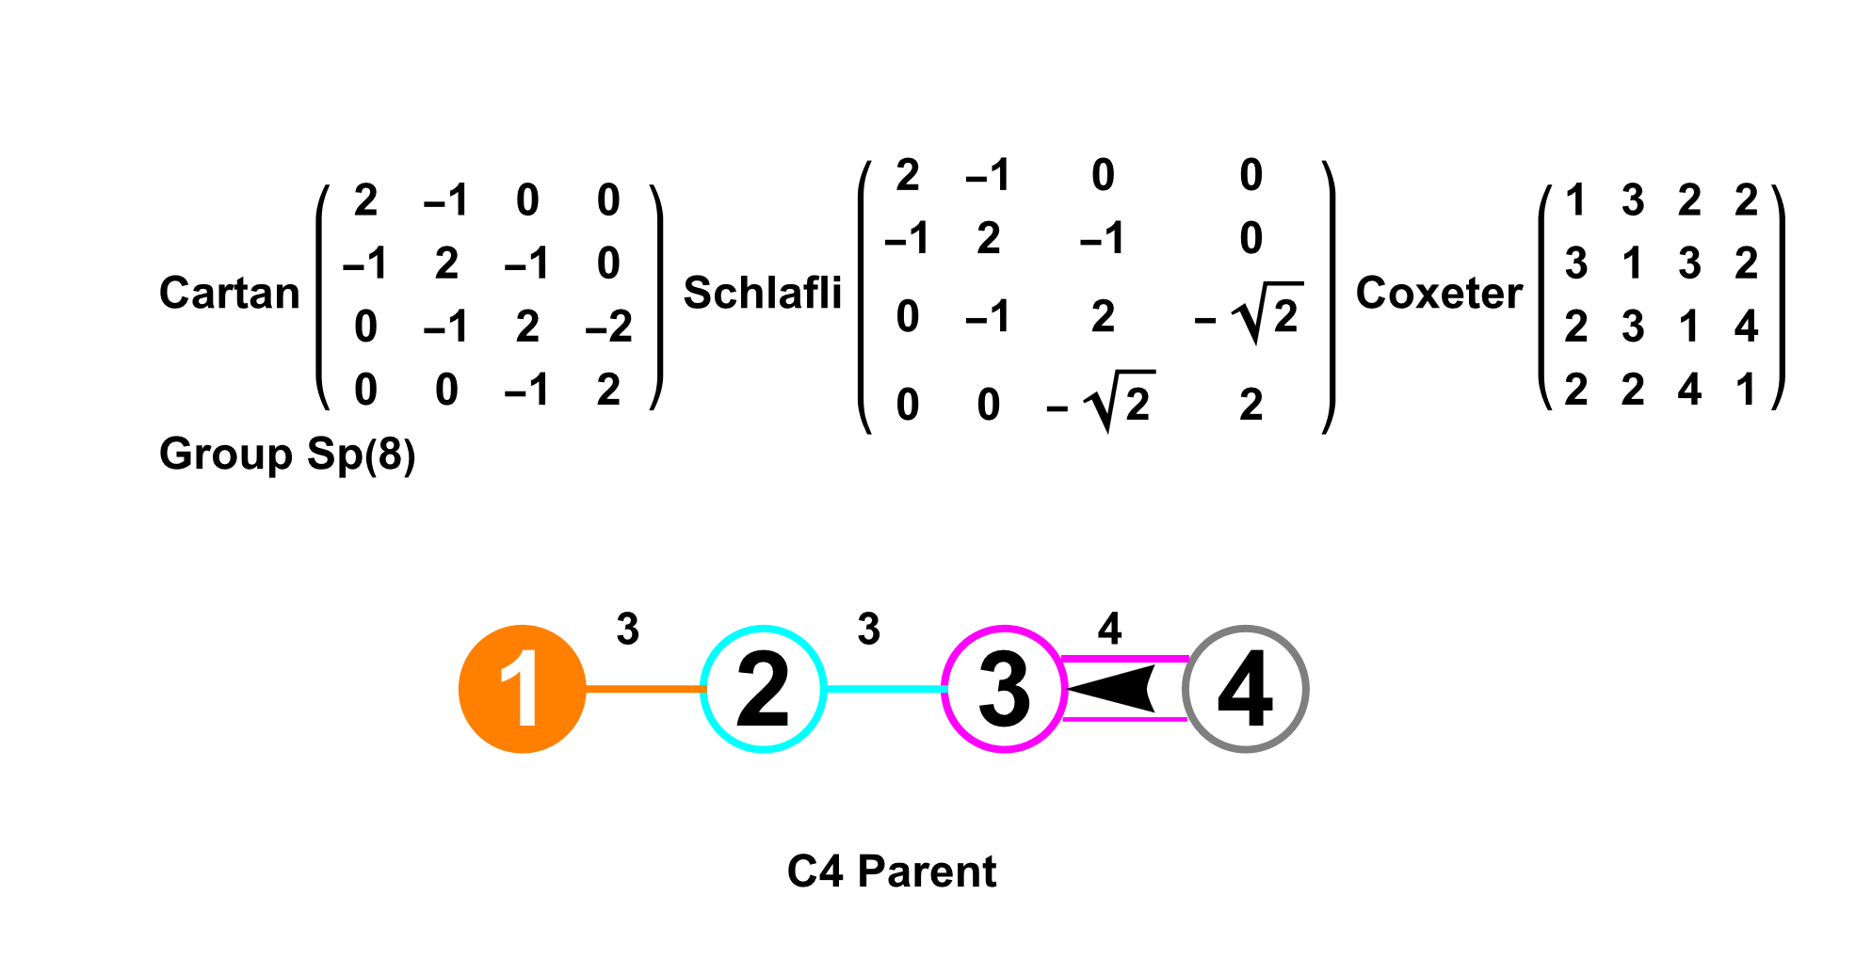
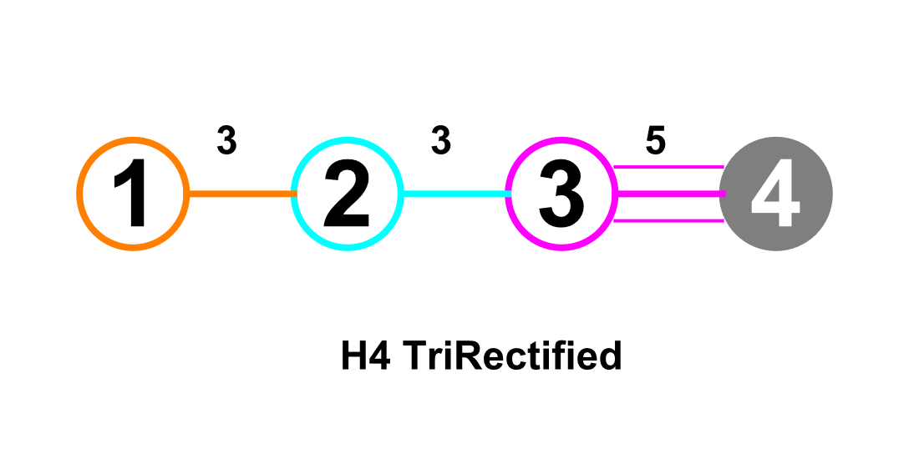
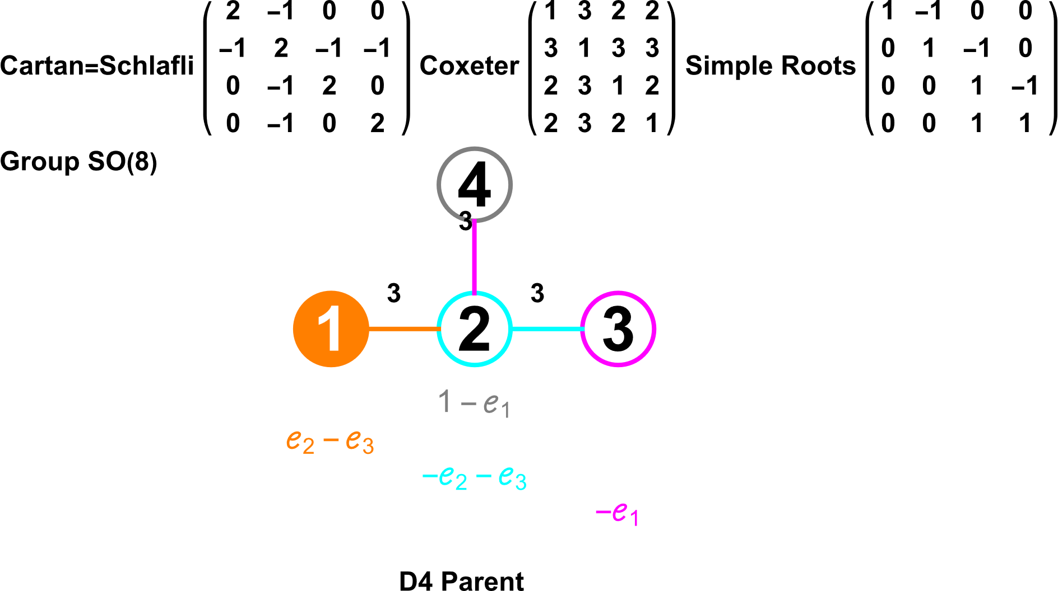
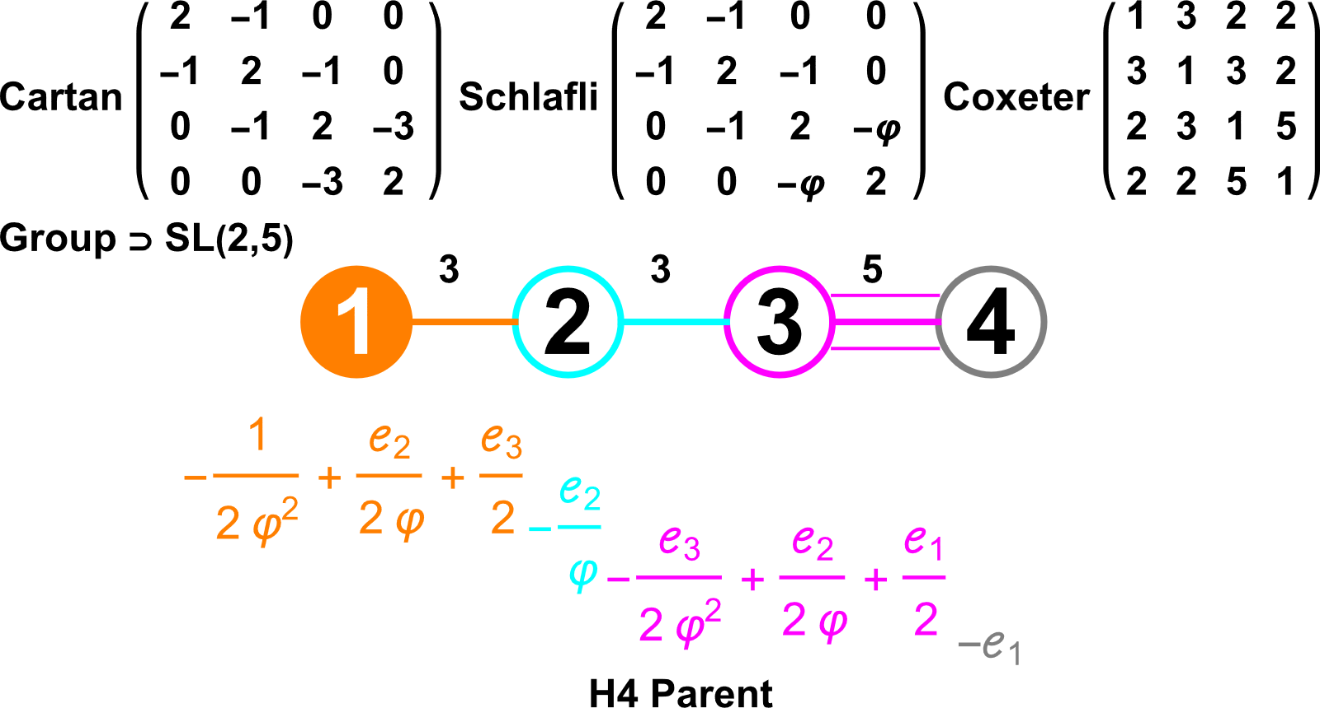
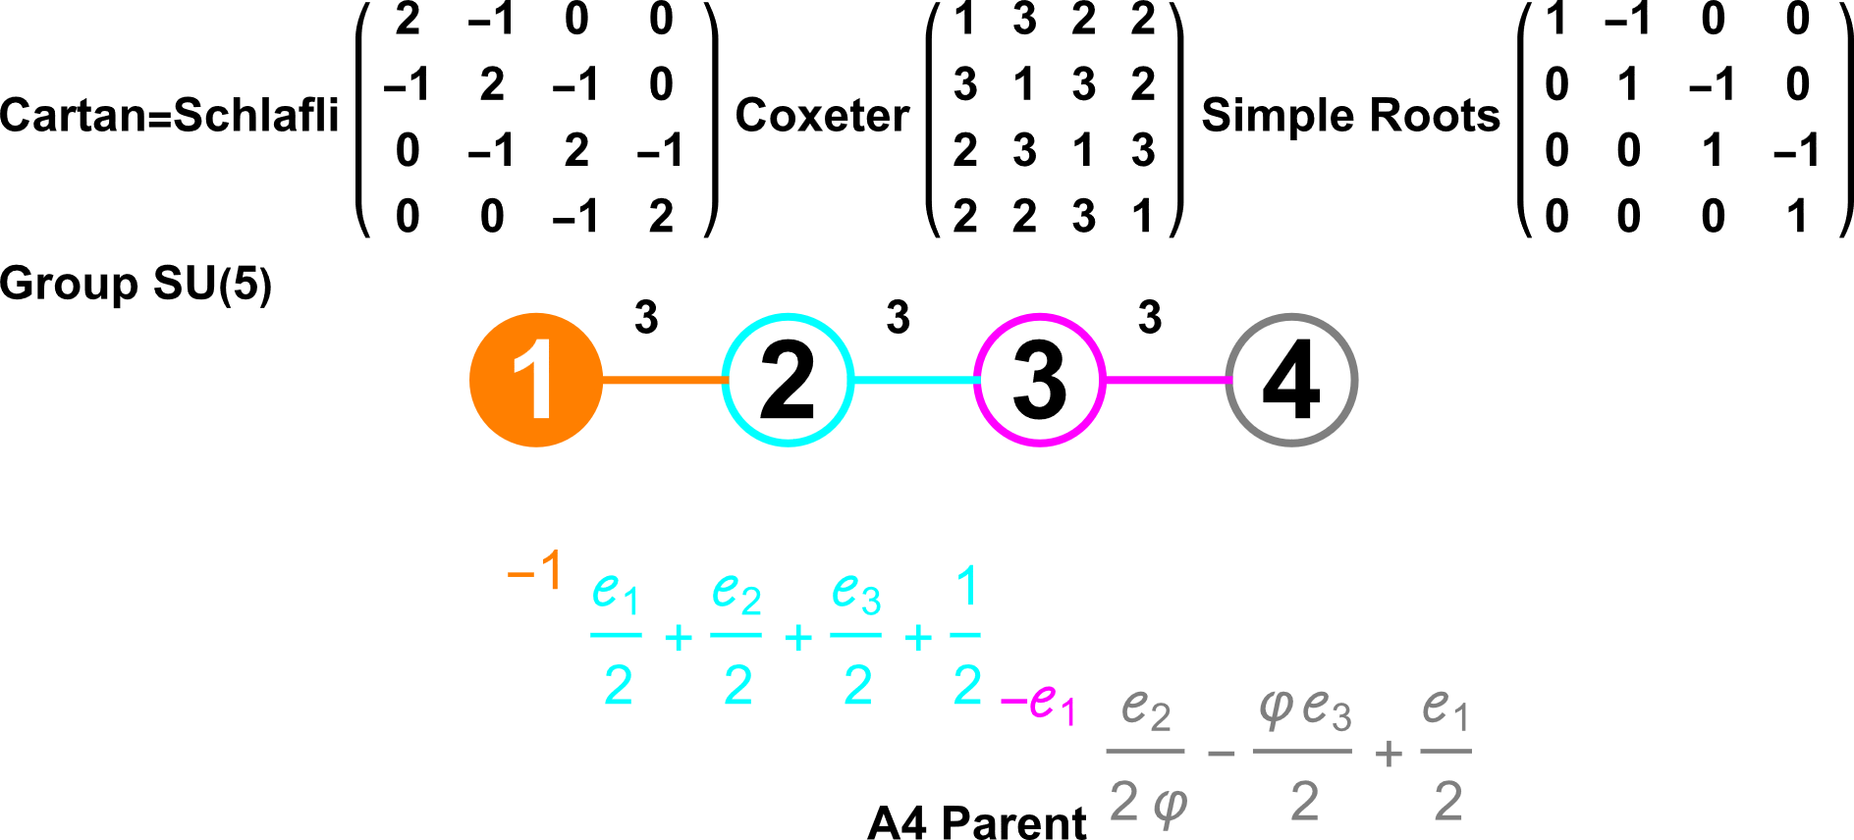
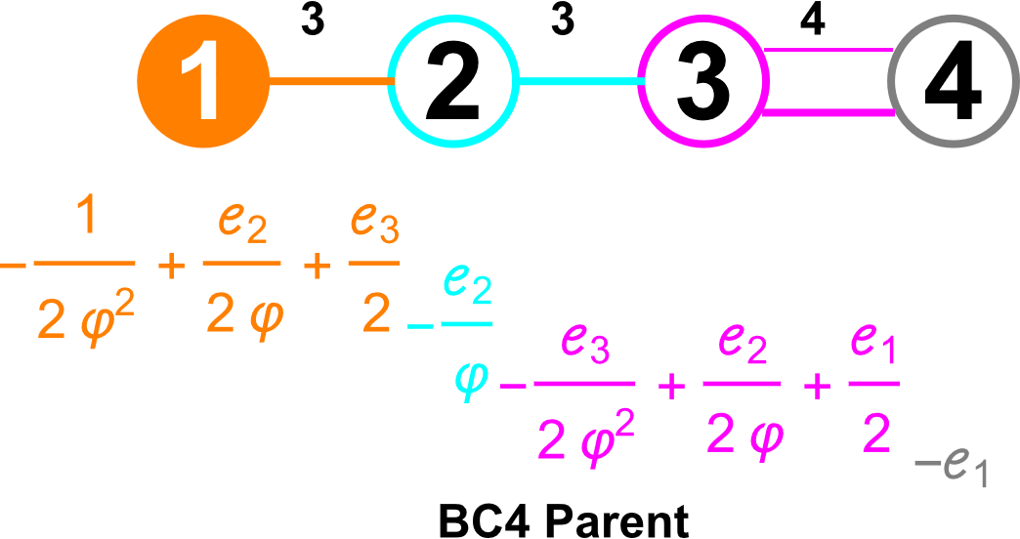
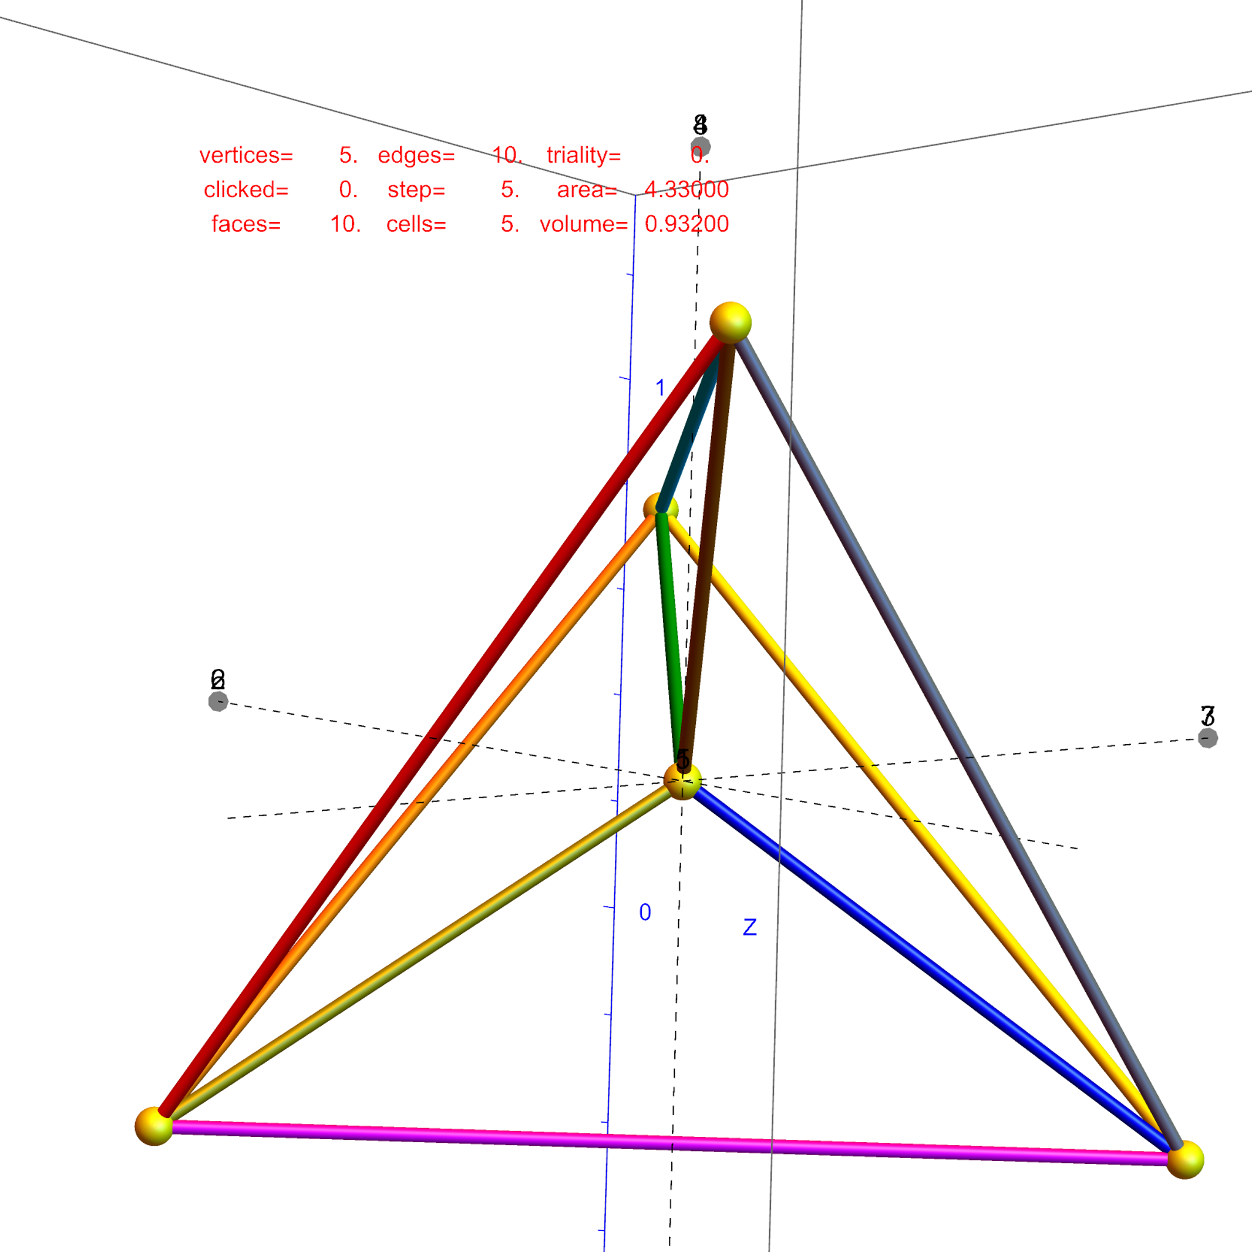
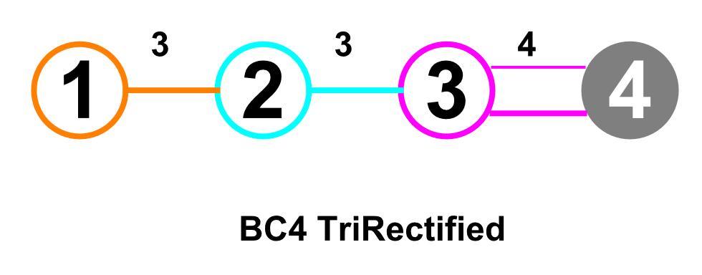
4D cells & polychora (A4, C4, D4, F4, H4)
16=2^{n=4} permutations of filled (aka. ringed) nodes represent which Weyl orbits that generate sets of vertices, edges, faces, and cells. The names are generated based on permutations of:
5-Cell (Self Dual) 16-Cell (BC4) 24-Cell (Self Dual) 600-Cell (H4)
8-Cell (BC4 TriRectified aka. Tesseract) 120-Cell (H4 TriRectified)

Slide 19
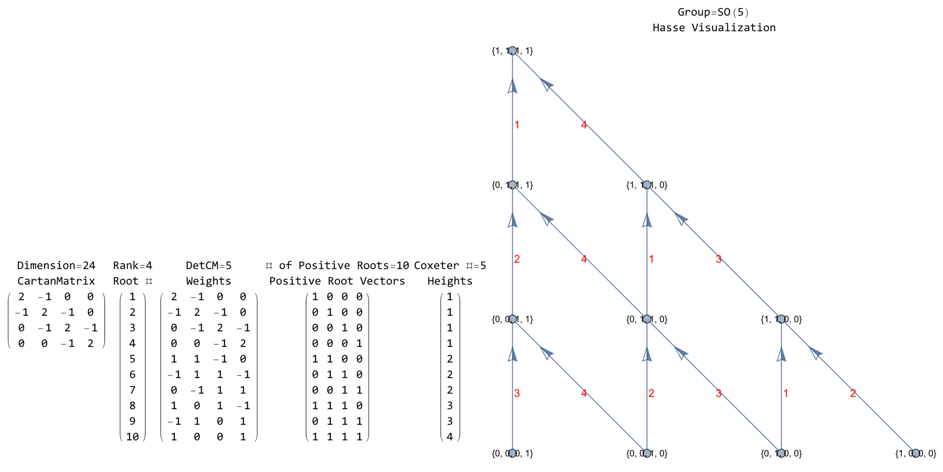
4D cells & polychora (A4, C4, D4, F4, H4)

Slide 20
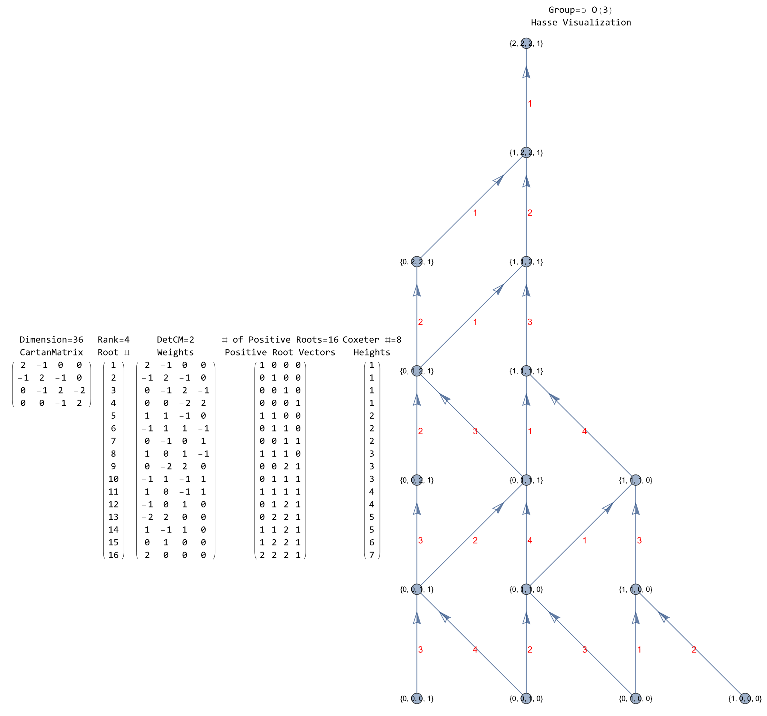
4D cells & polychora (A4, C4, D4, F4, H4)

Slide 21
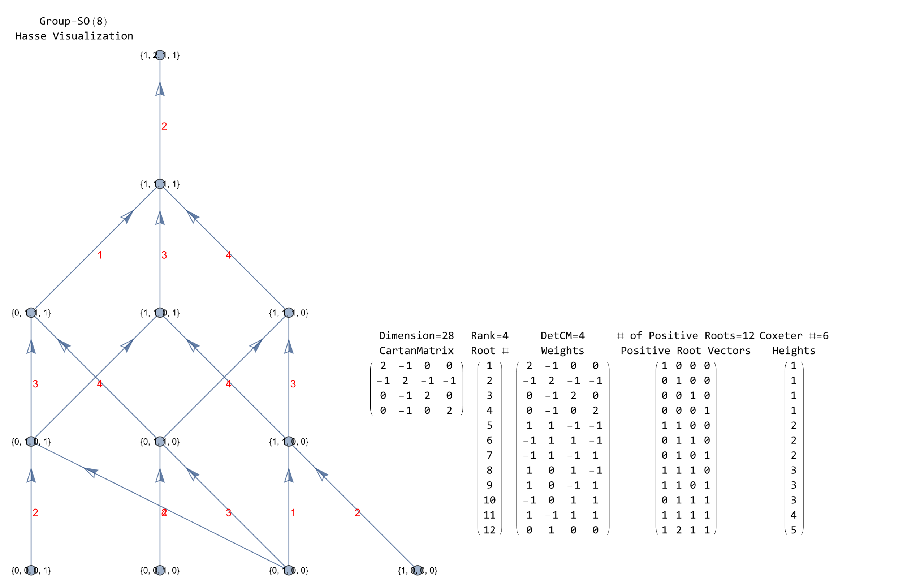
4D cells & polychora (A4, C4, D4, F4, H4)

Slide 22
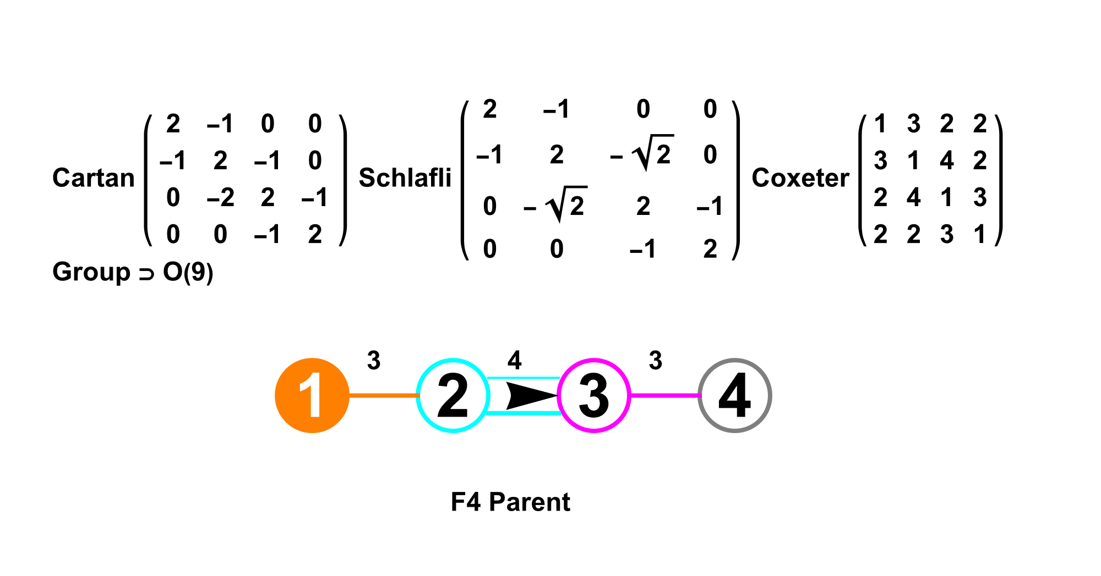
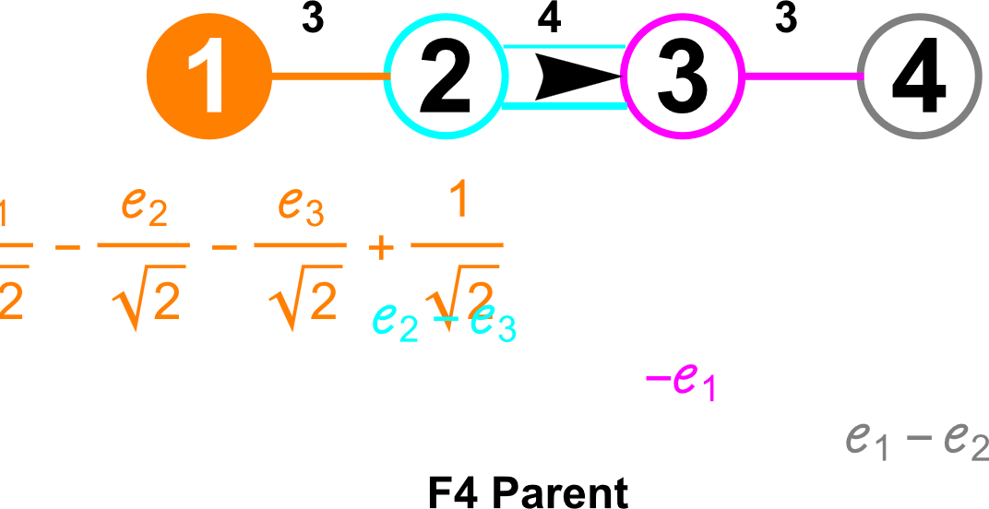
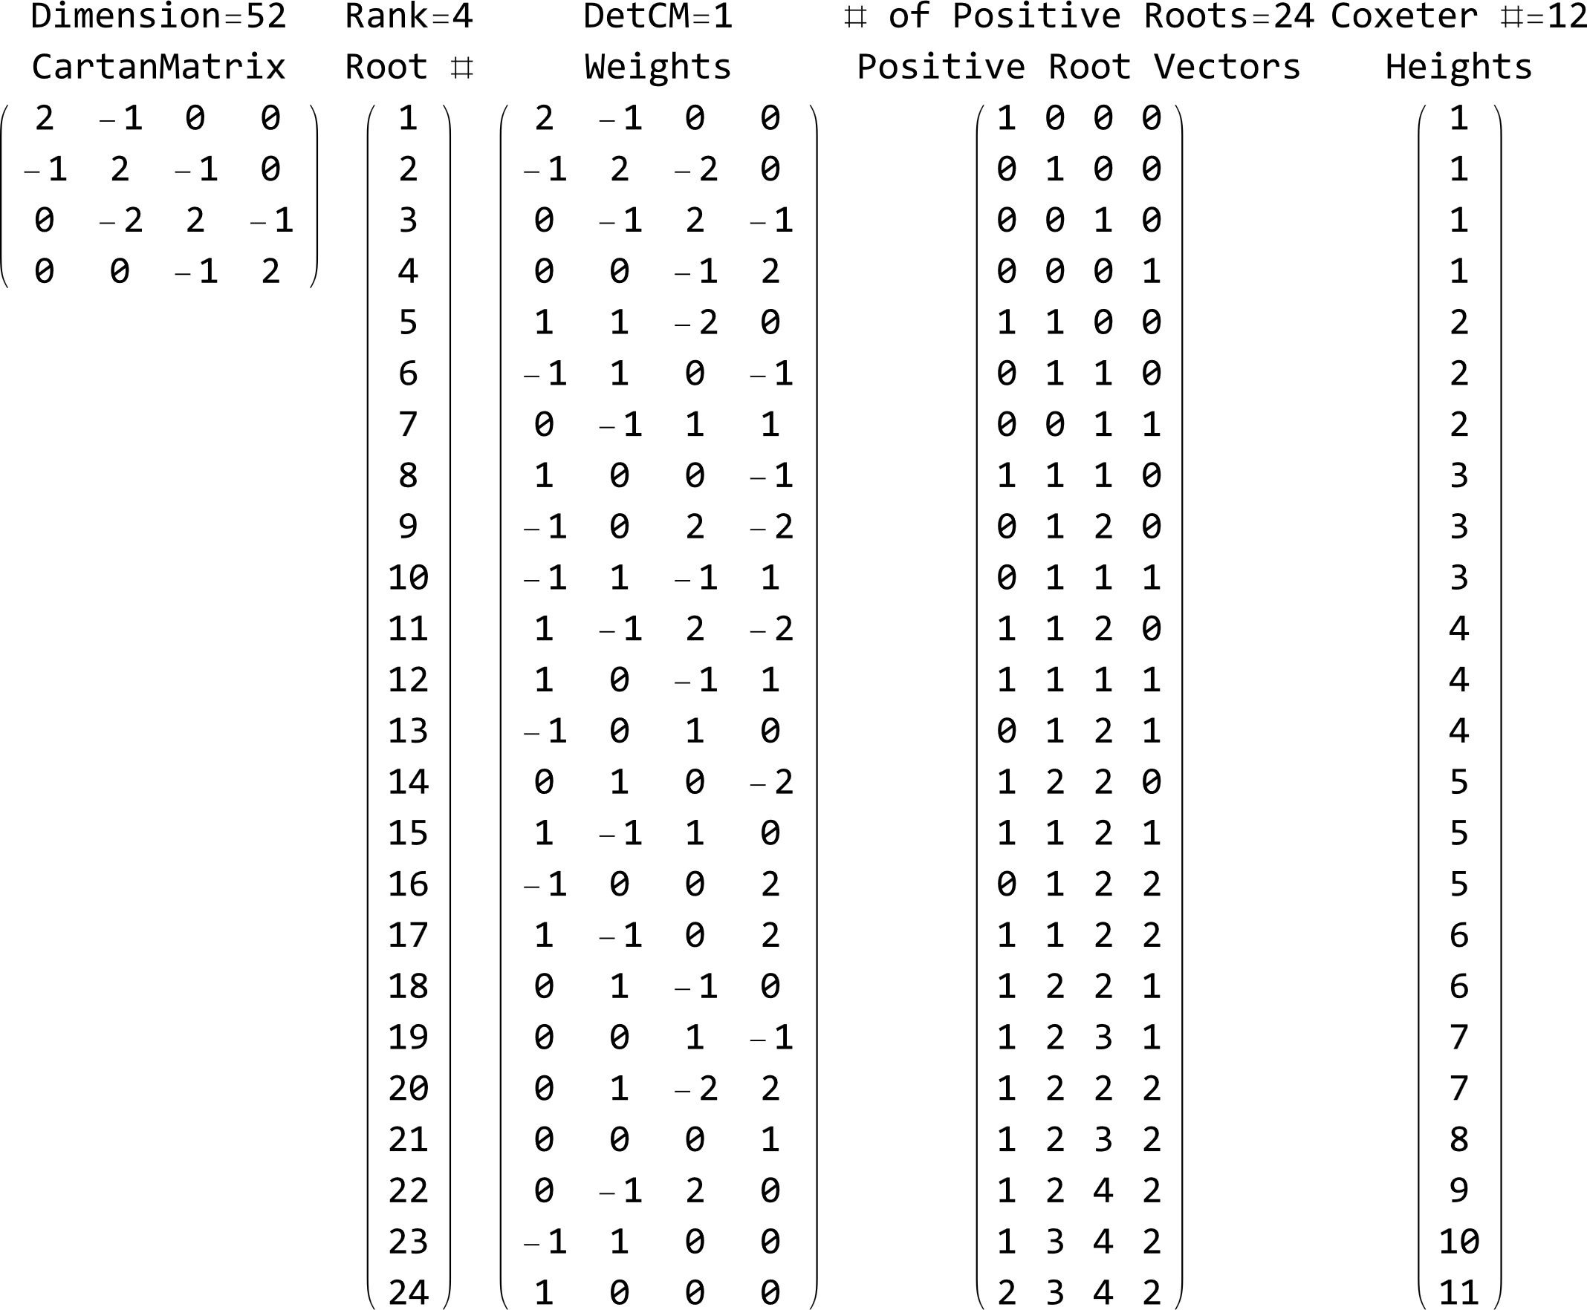
4D cells & polychora (A4, C4, D4, F4, H4)

Slide 23
4D cells & polychora (A4, C4, D4, F4, H4)

Slide 24
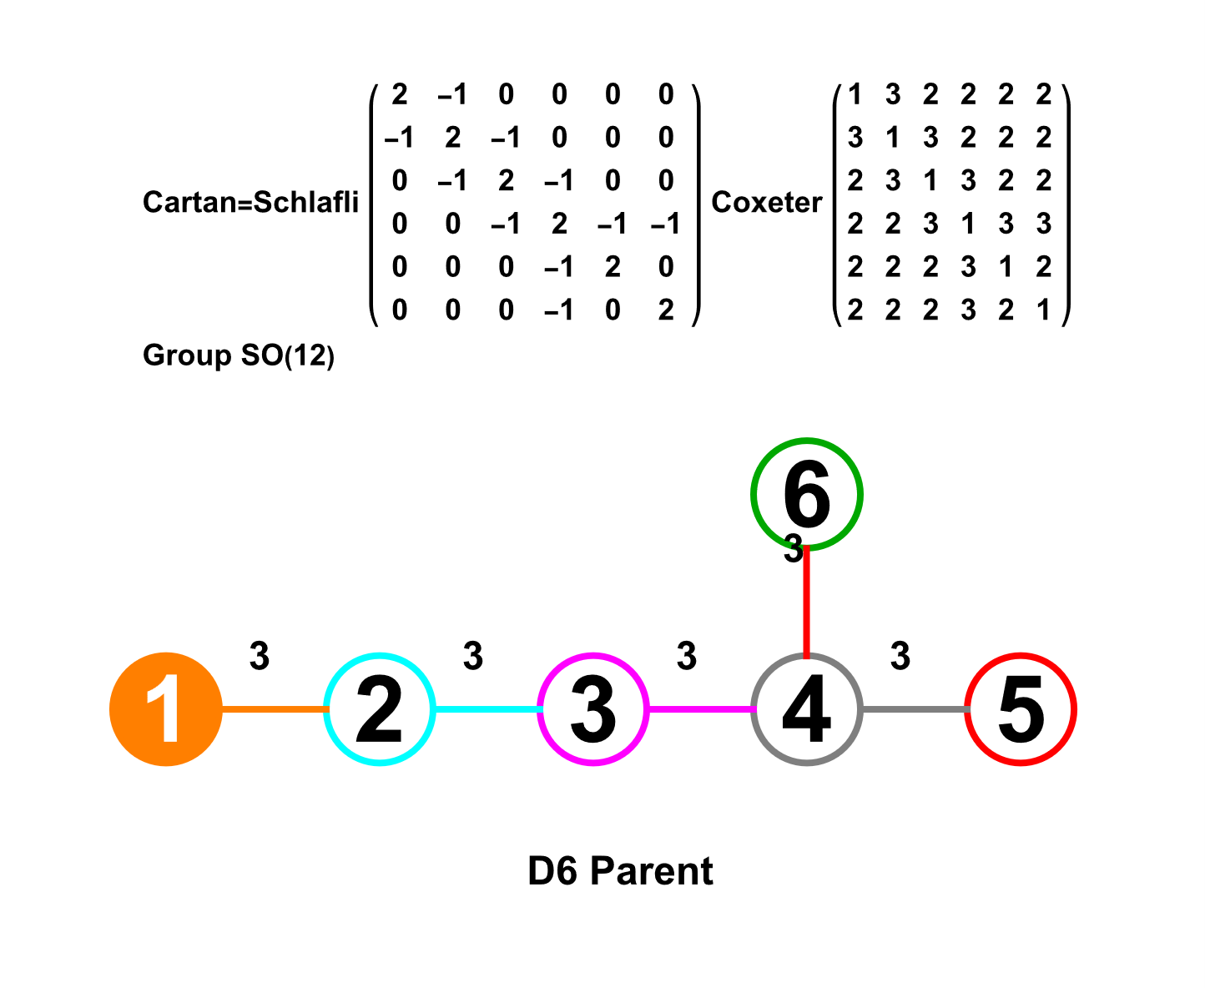
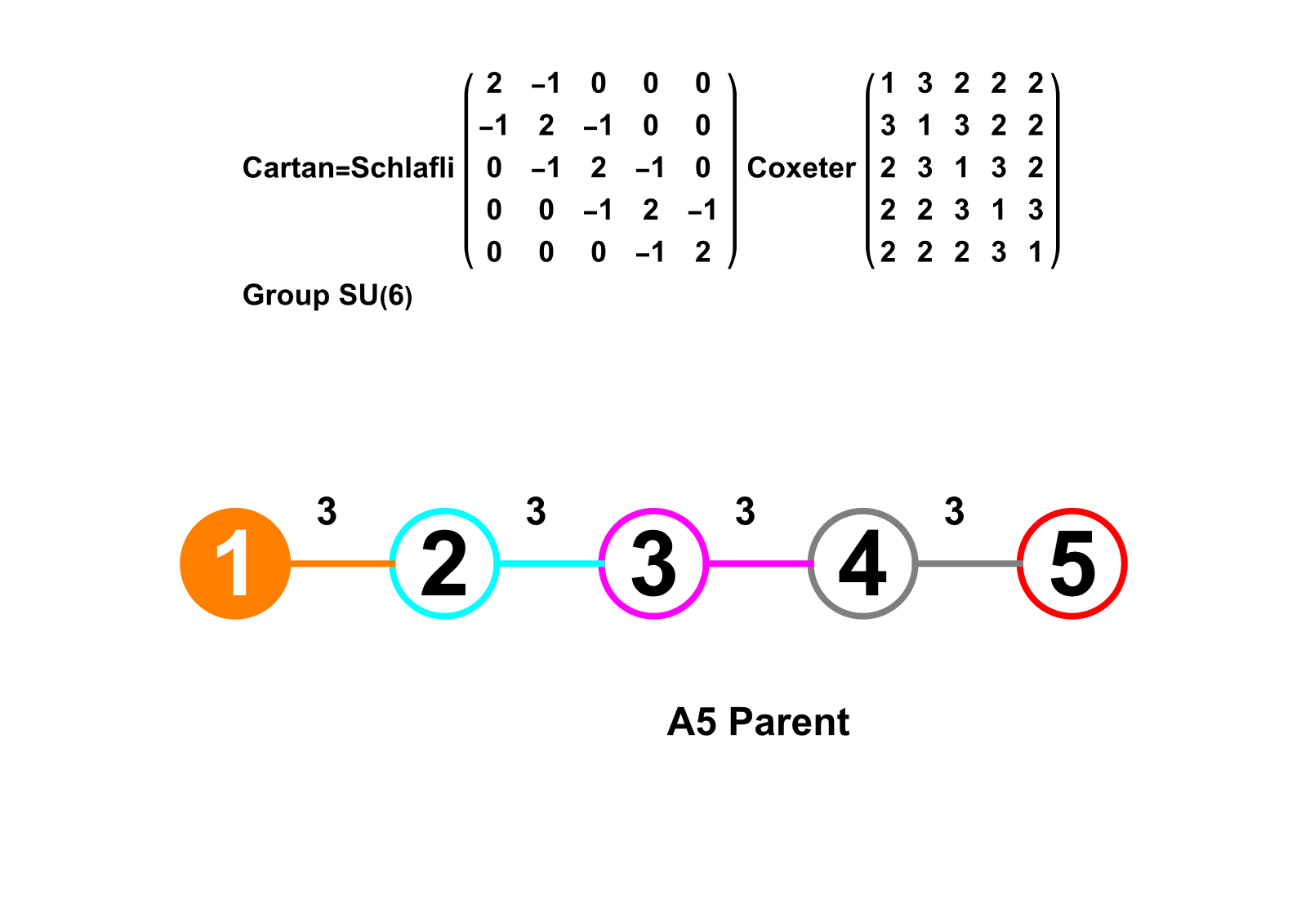
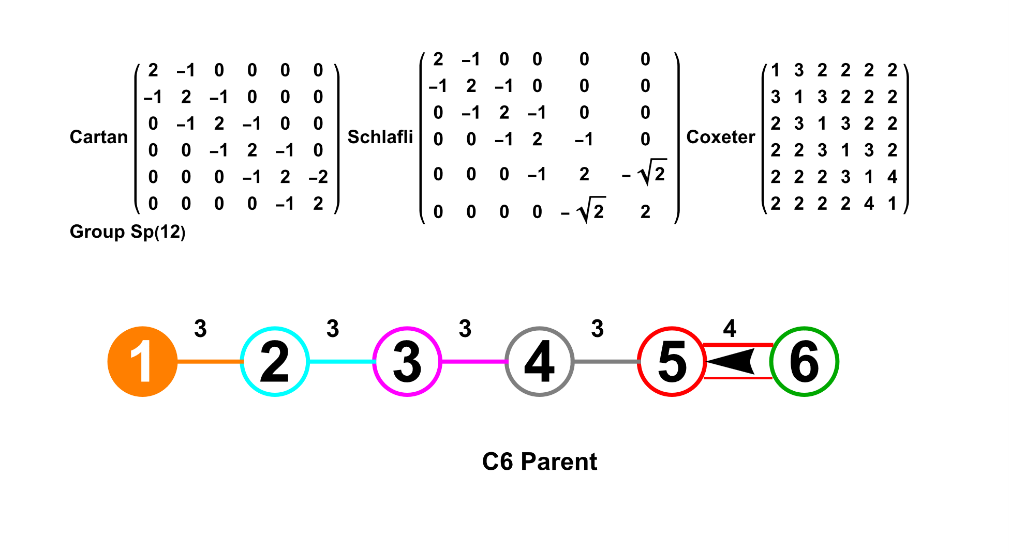
5D-8D cells & polytopes (A5, C6, D6, E6, E7, E8=BC8+D8)

Slide 25
5D-8D cells & polytopes (A5, C6, D6, E6, E7, E8=BC8+D8)

Slide 26
5D-8D cells & polytopes (A5, C6, D6, E6, E7, E8=BC8+D8)
BC6 Hexeract

Slide 27
5D-8D cells & polytopes (A5, C6, D6, E6, E7, E8=BC8+D8)

Slide 28
5D-8D cells & polytopes (A5, C6, D6, E6, E7, E8=BC8+D8)

Slide 29
5D-8D cells & polytopes (A5, C6, D6, E6, E7, E8=BC8+D8)

Slide 30
5D-8D cells & polytopes (A5, C6, D6, E6, E7, E8=BC8+D8)
256=2^{n=8} permutations of filled (aka. ringed) nodes which represent Weyl orbits that generate sets of vertices, edges, faces, and cells. The names are generated based on: permutations of:

Slide 31
5D-8D cells & polytopes (A5, C6, D6, E6, E7, E8=BC8+D8)
4 + 4
E8 Maximal Embeddings
SO(16)=D8 Height 120=(112+4+4)+128’ .
BC8

Slide 32
5D-8D cells & polytopes (A5, C6, D6, E6, E7, E8=BC8+D8)
4 + 4
C8 Maximal Embeddings Height 128+4+4 .
4 + 4
4 + 4
+4+4
D8 Maximal Embeddings Height 112+4+4 .

Slide 33
Agenda
Introducing the Mathematica™ based VisibLie-E8 Tool
The Coxeter-Dynkin Visualizer (Groups, Weyl Orbits, Hasse Diagrams, etc.)
The (Bi)Quaternion/(Bi)Octonion/Sedenion Engine (Fano Plane/Cube/Tesseract, etc.)
The VisibLie_E8 Hyperdimensional Visualizer (2D/3D Projections, etc.)
Introducing the Dimensions (0 to 8, ∞)
0D points, 1D edges & 2D faces (A2, B2=C2, G2, H2 Groups)
3D cells & polyhedra (A3, B3, H3 Groups)
4D cells & polychora (A4, C4, D4, F4, H4 Groups)
5D-8D cells & polytopes (A5, C6, D6, E6, E7, E8=BC8+D8 Groups)
Generating Solid Convex Hulls from Quaternions and their Weyl Group Orbits
The 5 Platonic Solids, which includes duals
The 13 Archimedean Solids and their Catalan Duals, with some Johnson and Near-miss Johnsons
4D Polychora w/Duals, including the Dual Snub 24-Cell

Slide 34
Generating Solid Convex Hulls from Quaternions and their Weyl Group Orbits
This is from the Wikipedia page describing the mathematics behind the 4D quaternion polytopes generated in this presentation.
D4
T =Rectified (if node 2 is in the middle of D4 or Parent if it is on left)
V1 =Parent (if node 2 is in the middle of D4 or Rectified if it is on left)
V2 =BiRectified
V3 =TriRectified
T' =CantiRuncinated (if node 2 is in the middle of D4 or BiCantiTruncated if it is on left)
T+T'=OmniTruncated
with Snub=O(0000)

Slide 35
Generating Solid Convex Hulls from Quaternions and their Weyl Group Orbits
These are snippets of my Mathematica implementation which supports the generation of the output shown.

Slide 36
Generating Solid Convex Hulls from Quaternions and their Weyl Group Orbits
This is example code that initiates the generation of the output.
hulls3D gathers the vertices by their 3D norm and calculates each concentric convex hull with increasing opacity and varying colors.
The Λ function takes as input a function (e.g. oCalc to only calculate the orbit vertices, vs. oShow which also generates the convex hulls using hulls3D). Scaling can be applied before or after calling Λ or oCalc.
In this case, the {α,β,γ} are quaternions {e₁,e₂,e₃} or the group (e.g. “H3") and may depend on identifying a particular (optional or even scaled) Weyl orbit (i.e. {1,0,0} as the "Parent" of the diagram). Shown are the 7=2^{rank=3}-1 combinations of empty and filled nodes from the 3 node Coxeter-Dynkin diagrams, with {0,0,0} being a "Snub" (omitted here) and {1,1,1} being "OmniTruncated") .
The optional parameter "Osign" identifies one of 14 combinations of sign and/or position permutations (i.e. this one takes only Odd sign permutations from the cyclic position permutations (vs. all sign permutations given by the default "Rotate").
This is the output from the example code on the left.

Slide 37
The 5 Platonic Solids, which includes their Duals
A₃ B₃ H₃
100
010
001
101
110
011
111
Tetrahedron (Self Dual)

Slide 38
The 5 Platonic Solids, which includes their Duals
A₃ B₃ H₃
100
010
001
101
110
011
111
Octahedron (Cube)

Slide 39
The 5 Platonic Solids, which includes their Duals
A₃ B₃ H₃
100
010
001
101
110
011
111
Dodecahedron (Icosahedron)

Slide 40
The 13 Archimedean Solids with their Catalan Duals with some Johnson and Near-miss Johnsons
A₃ B₃ H₃
100
010
001
101
110
011
111
Truncated Tetrahedron (Triakis Tetrahedron)
Mirrored Pairs - Irregular Small Rhombicuboctahedron

Slide 41
The 13 Archimedean Solids with their Catalan Duals with some Johnson and Near-miss Johnsons
A₃ B₃ H₃
100
010
001
101
110
011
111
Cuboctahedron (Rhombic Dodecahedron)

Slide 42
The 13 Archimedean Solids with their Catalan Duals with some Johnson and Near-miss Johnsons
A₃ B₃ H₃
100
010
001
101
110
011
111
Truncated Octahedron (Tetrakis Hexahedron)

Slide 43
The 13 Archimedean Solids with their Catalan Duals with some Johnson and Near-miss Johnsons
A₃ B₃ H₃
100
010
001
101
110
011
111
Small Rhombicuboctahedron (Deltoidal Icositetrahedron)

Slide 44
The 13 Archimedean Solids with their Catalan Duals with some Johnson and Near-miss Johnsons
A₃ B₃ H₃
100
010
001
101
110
011
111
Truncated Cube (Triakis Octahedron)

Slide 45
The 13 Archimedean Solids with their Catalan Duals with some Johnson and Near-miss Johnsons
A₃ B₃ H₃
100
010
001
101
110
011
111
Great Rhombicosidodecahedron (Disdyakis Dodecahedron)

Slide 46
The 13 Archimedean Solids with their Catalan Duals with some Johnson and Near-miss Johnsons
A₃ B₃ H₃
100
010
001
101
110
011
111
Snub Cube (Pentagonal Icositetrahedron)
Mirrored Pairs - Irregular Great Rhombicosidodecahedron (prev slide)

Slide 47
The 13 Archimedean Solids with their Catalan Duals with some Johnson and Near-miss Johnsons
A₃ B₃ H₃
100
010
001
101
110
011
111
Truncated Dodecahedron (Triakis Icosahedron)

Slide 48
The 13 Archimedean Solids with their Catalan Duals with some Johnson and Near-miss Johnsons
A₃ B₃ H₃
100
010
001
101
110
011
111
Icosidodecahedron (Rhombic Triacontahedron)

Slide 49
The 13 Archimedean Solids with their Catalan Duals with some Johnson and Near-miss Johnsons
A₃ B₃ H₃
100
010
001
101
110
011
111
Truncated Icosahedron (Pentakis Dodecahedron)

Slide 50
The 13 Archimedean Solids with their Catalan Duals with some Johnson and Near-miss Johnsons
A₃ B₃ H₃
100
010
001
101
110
011
111
Small Rhombicosidodecahedron (Deltoidal Hexacontahedron)

Slide 51
The 13 Archimedean Solids with their Catalan Duals with some Johnson and Near-miss Johnsons
A₃ B₃ H₃
100
010
001
101
110
011
111
Snub Dodecahedron (Pentagonal Hexacontahedron)
Mirrored Pairs - Irregular Great Rhombicosidodecahedron (next slide)

Slide 52
The 13 Archimedean Solids with their Catalan Duals with some Johnson and Near-miss Johnsons
A₃ B₃ H₃
100
010
001
101
110
011
111
Great Rhombicosidodecahedron (Disdyakis Triacontahedron)

Slide 53
The 13 Archimedean Solids with their Catalan Duals with some Johnson and Near-miss Johnsons
Pentakis Icosidodecahedron (Chamfered Dodecahedron)
These are 3D (x,y,z) convex hulls projected from 4D group H4
(shown here with 4th Dim w=0)

Slide 54
Agenda
Introducing the Mathematica™ based VisibLie-E8 Tool
The Coxeter-Dynkin Visualizer (Groups, Weyl Orbits, Hasse Diagrams, etc.)
The (Bi)Quaternion/(Bi)Octonion/Sedenion Engine (Fano Plane/Cube/Tesseract, etc.)
The VisibLie_E8 Hyperdimensional Visualizer (2D/3D Projections, etc.)
Introducing the Dimensions (0 to 8, ∞)
0D points, 1D edges & 2D faces (A2, B2=C2, G2, H2 Groups)
3D cells & polyhedra (A3, B3, H3 Groups)
4D cells & polychora (A4, C4, D4, F4, H4 Groups)
5D-8D cells & polytopes (A5, C6, D6, E6, E7, E8=BC8+D8 Groups)
Generating Solid Convex Hulls from Quaternions and their Weyl Group Orbits
The 5 Platonic Solids, which includes duals
The 13 Archimedean Solids and their Catalan Duals, with some Johnson and Near-miss Johnsons
4D Polychora w/Duals, including the Dual Snub 24-Cell

Slide 55
The 600-Cell / 120-Cell Quaternion 3D Structure
(T)etrahedral elements=D4(24)=16-Cell(BC4)+8-Cell(TriRectified BC4)=24-Cell
Alternate (or "Dual" of Self Dual D4) T'=Rectified BC4 (16-Cell): F4(48)=T+T' and T+T'+ϕ(T+T') are 2X(48 of 112) integer vertex parts of E8 folded to (I=H4)+ϕH4
Orthogonal projection in 3 dimensions with {x=1,y=1,z=1,w=0}
all other permutations simply rotate the structure
T 24-Cell
in 3D
Catalan Solid
Rhombic Dodecahedron
Sorted Positive (2*2+2*4) T=
ϕT=
Sorted Positive (2*3+3*2) T’=
T' 24-Cell
in 3D
ϕT’=
Archimedian Solid
Cuboctahedron

Slide 56
The 600-Cell / 120-Cell Quaternion 3D Structure
16-Cell+8-Cell=24-Cell Tetrahedral elements: (T+ϕT) & (T'+ ϕT')
Orthogonal projection in 3 dimensions with {x=1,y=1,z=1,w=0}
all other permutations simply rotate the structure
3D
Rhombic
Dodecahedron
(6+8=14 vertex)
T 24-Cell
in 3D
3D Cube
from 4D Tesseract
or 8-Cell
(16 vertex)
Cube
Stellation
vs.
Cube
Truncation
3D Norm r= √3/2
3D Norm r=1
3D
Octahedron
+ 2@origin
from 4D
16-Cell
(8 vertex)
T' 24-Cell
in 3D
3D Norm r=1/ √ 2
3D Norm r=1
3D
Cubocta-
Hedron
(12 vertex)

Slide 57
The 600-Cell / 120-Cell Quaternion Structure
Both the 120 vertex 600-Cell(120) and the 600 vertex 120-Cell(600) can be generated from quaternion T(24) or T'(24) basis vectors one or two exponents (i,j=0-4) on one or two generator vertices (p^{i}, p^{j}) (see Koca 2011 et al.).
The H4 600-Cell Icosahedral group I(120) (or its alternate I' using T' instead of T) is generated from p^{i} only.
This gives us the ability to map the 120-Cell vertices to each of the 5 copies of 600-Cell vertices.
This mapping includes the other orbits of the Weyl group W(D4) as well, e.g. M(192)=M1(96)+M2(96), and N(288).
As done with the 600-Cell, implementing the 120-Cell in this manner allows the use of not only two the scaled copies of the 120-Cell (J & Jϕ).

Slide 58
The 600-Cell / 120-Cell Quaternion 3D Structure
Snub 24-Cell (S=I-T) (96) and Alternate (S‘=I’-T’)

Slide 59
The 600-Cell / 120-Cell Quaternion 3D Structure
Dual Snub 24-Cell (144 ) and Alternate Dual Snub 24-Cell

Slide 60
The 600-Cell / 120-Cell Quaternion 3D Structure
3D Hull Visualization of the H4 600-Cell Real & Quaternion Icosian (I)
I (120) and Alternate I’ (120)
α=p= .
Platonic Solid
Icosahedron
Platonic Solid(s)
Tetrahedrons-Cube
Archimedian Solid
Small Rhombicuboctahedron
Same I & I’ outer hulls for all
{p, p*} ϵ I
Platonic Solid
Dodecahedron
Platonic Solid
Octahedron
Archimedian Solid
Icosidodecahedron
Archimedian Solid*
Truncated Cube
Pentakis Icosidodecahedron
New Solid TBN?
I’ overall hull is similar to
I with 6 opposing squares
vs.
triangles in I
*Quasi-regular polygons

Slide 61
The 600-Cell / 120-Cell Quaternion 3D Structure
3D Hull Visualization of the 600-Cell Real & Quaternion Icosian (I)=H4
E8(SRE)↔ H4(120)+H4ϕ(120) with particle assignments
The 600-cell has an outer 3D hull of a Pentakis Icosidodecahedron (as shown above in slide #51)
Which is the dual to the Truncated Rhombic Triacontahedron or Chamfered Dodecahedron
(being the outer 3D hull of the 120-Cell orthogonally projected to 3D)

Slide 62
The 600-Cell / 120-Cell Quaternion 3D Structure
It is important to note that all the indices below also work for both the canonical 120-Cell (J) values as well as an alternate form (J').
This (J) is implemented natively inside the VisibLie_E8 viewer based on the Koca's quaternion generation reproduces the canonical permutation vertex values exactly using , where
p=α= .
This equality allows re-sorting of the canonical values to index to the I(120)x5 quaternion powers.
The (J') alternate T quaternion generated vertex set is implemented by using the auxData.xls input data file.
This file contains the same sort as the J for its vertex data exported from Mathematica, which allows the use of the same Weyl W(D4) orbit indices.

Slide 63
The 600-Cell / 120-Cell Quaternion 3D Structure
3D Hull Visualization of the 120-Cell (J) and Alternate J’ (600) .
Using I and one exponent (a=0-4)
Orthogonal projection in 3 dimensions with {x=1,y=1,z=1,w=0}
all other permutations simply rotate the structure
~½ the permutations of α ϵ I w/c’(or c) ϵ T’(or T) produce these J, or J’, (or 600 vertex hulls of I, I’, T, or T’) on each of the 4 3D subsets.
With other perms not uniform within their subsets and having less uniform faces geometry.
c’= α = c =
Archimedian Solid
Rhombicosidodecahedron
Truncated Rhombic Triacontahedron or Chamfered Dodecahedron
New Solid TBN
(To-Be-Named)?

Slide 64
The 600-Cell / 120-Cell Quaternion 3D Structure
3D Hull Visualization of the 120-Cell (J) and Alternate J’ (600) .
Using two exponent (a=0-4,b=0,4)
α=
β =
~½ the permutations of {α,β} as functions
of c ϵ T & q ϵ I produce J, J’, I, I’, T, or T’ on each of the 4 3D subsets.
New Solid TBN?
This J’ is identical to the 1 exponent J’ →
← This J has identical Norm’d hull radii and vertex counts
to the 1 exponent J
but with different hull shapes.
New Solid TBN?
J’ overall hull is the same as I’
Which is similar to I
with 6 opposing squares
vs. triangles in I with identical
Norm’d hull radii & x5x counts!

Slide 65
The 600-Cell / 120-Cell Quaternion 3D Structure
3D Visualization of the 120-Cell (J):
3D Visualization of the 120-Cell (J’)
with particle assignments
produced with:
The outer 3D hull is the Truncated Rhombic Triacontahedron or Chamfered Dodecahedron
Is this outer 3D hull a new near-miss Johnson Solid?

Slide 66
The 600-Cell / 120-Cell Quaternion 3D Structure
3D Visualization of the 120-Cell (J) with an overlay of the Dual Snub 24-Cell to the right showing the Tetrahedrons establishing the pentagaonal faces:
The outer 3D hull is the Truncated Rhombic Triacontahedron or Chamfered Dodecahedron

Slide 67
The 600-Cell / 120-Cell Quaternion 3D Structure
24-Cell (T) to 600-Cell (I) and 600-Cell (I) to 120-Cell (J)
Animations building from exponent a=0-4

Slide 68
The 600-Cell / 120-Cell Quaternion 3D Structure
3D Hull Visualization of the 120-Cell (J) and Alternate J’ (600) .
Examples of permutations that are not uniform within the 4 3D subsets of a 4D polytope and having less uniform faces geometry.
Some approximate the Dual Snub24-Cell.
These are natural rotations of a 4D polytope when projected to 3D. The fact they emerge within the limited quaternion exponents is interesting.

